Slide 1
Linux Basics & Troubleshooting
MTU LUG

Slide 2
Overview
What is linux?
FHS/LS/mounts
Formatting
Package Managers
Helpful commands and logs

Slide 3
What is linux?
Linux kernel - interface between hardware and software
GNU - userspace software that sits on the kernel
Linux distribution - different kernel options and userspace software bundled together

Slide 4
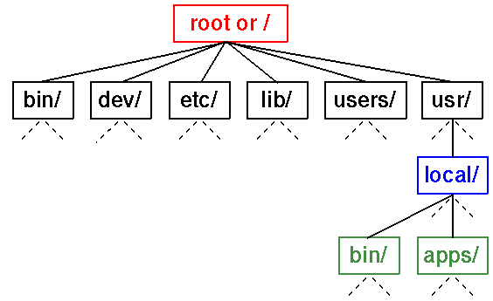
File System Hierarchy
LSB, Linux Foundation
Everything is a file
Mount points

Slide 5
Mounting a new drive
# fdisk /dev/sdb
# mkfs.ext4 /dev/sdb1
# mount /dev/sdb1 /storage
# df -h

Slide 6
Package managers
Use a repo to store all software
  hence lug repo mirrors!
apt-get, aptitude, pacman, yum, dnf, etc are higher-level than dpkg, rpm, etc
Resolve dependencies, track software, manage updates
Think of it like the app store?

Slide 7
Using local repos
/etc/apt/sources.list
  Can often replace with your local mirror
  :%s/us.archive.ubuntu.com/mirrors.lug.mtu.edu/g
/etc/yum.repos.d
  Can be more tricky, fastestmirror plugin and whatnot

Slide 8
Log files
Logs! Usually more useful than event viewer
/var/log
application and system logs are usually rotated with logrotate, /etc/logrotate.conf and /etc/logrotate.d
Journalctl if you use a OS with SystemD

Slide 9
Useful log files
** can depend on your distro! **
syslog - general system log files
messages - ^^
dmesg - kernel messages
auth.log - login success/failure, sudo failures
journalctl basically all of the above in one

Slide 10
Useful commands
top, ps, free, df, du
ifconfig - sort of like ipconfig on windows
dmesg - spits out contents of /var/log/dmesg
find / -iname *.bbq
which - find bin that a binary is in
sudo - when things don’t work - you can’t do this on campus machines

Slide 11
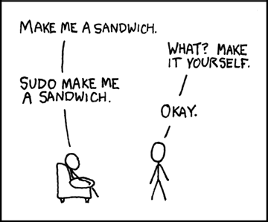
Sudo
Run command as root
Limit access to commands
“Safer” than using root
sudo !! - because we all forget
sudo su - switch to root
visudo - edit who can do what

Slide 12
Troubleshooting
What you already know applies to Linux
Check the log files
Figure out what’s really wrong
Google, IRC, forums. You’re not the first

