Slide 1
MTU LUG
General Meeting
2018/04/18

Slide 2
Announcements
New Meeting Time
  Wednesday @ 8 in Rekhi G009
K-Day...?
Elections!

Slide 3
eBoard Updates
President update
Vice-President update
Server Team update

Slide 4
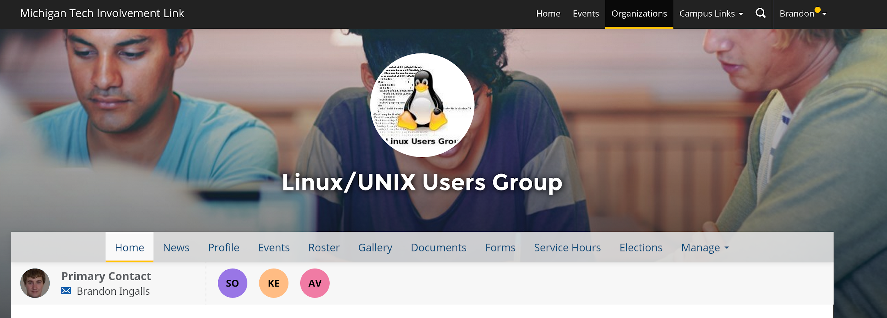
Join LUG Involvement
https://www.involvement.mtu.edu/organization/lug

Slide 5

Join LUG
Join us on:
Slack
  mtulug.slack.com
  (use @mtu.edu)
Keybase
  keybase.io
  (join team “mtu”)
IRC

Slide 6
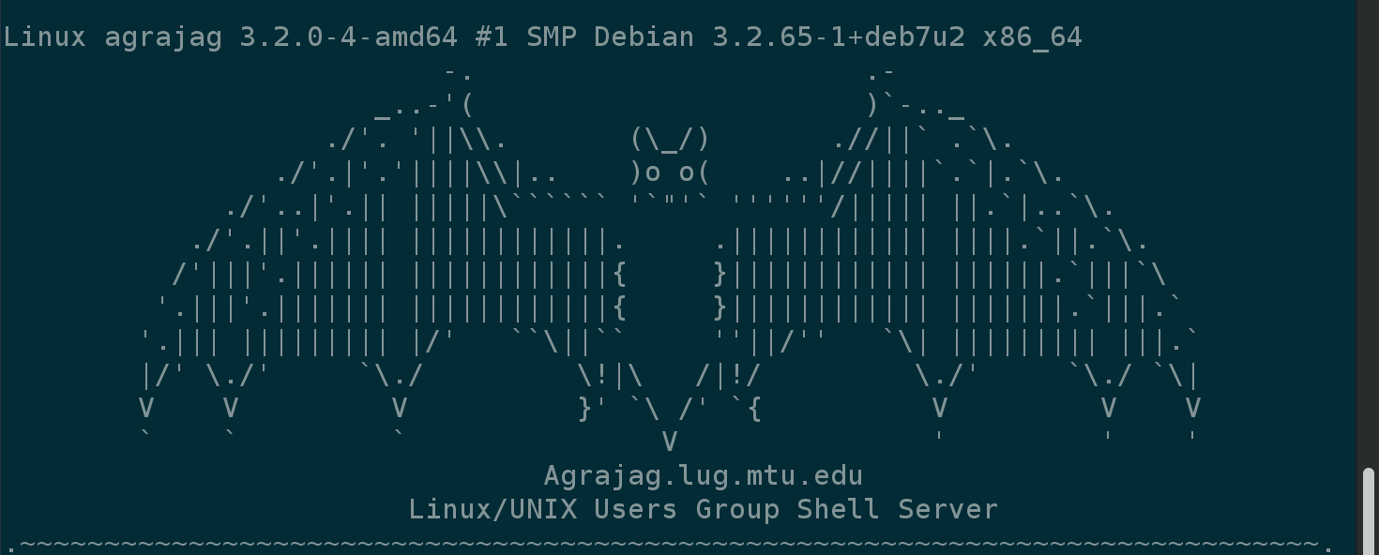
Shell Server (still down)
Account if
  have been to three general meetings
shell.lug.mtu.edu

Slide 7
Elections!
President: Jake Black
VP: Paul Esch-Laurent
Secretary: Eric Steve
Treasurer: Zach Jones
Server Team: Matt Miller, Zach Jones, and Eric Steve

Slide 8
/r/unixporn picks of the week

Slide 9
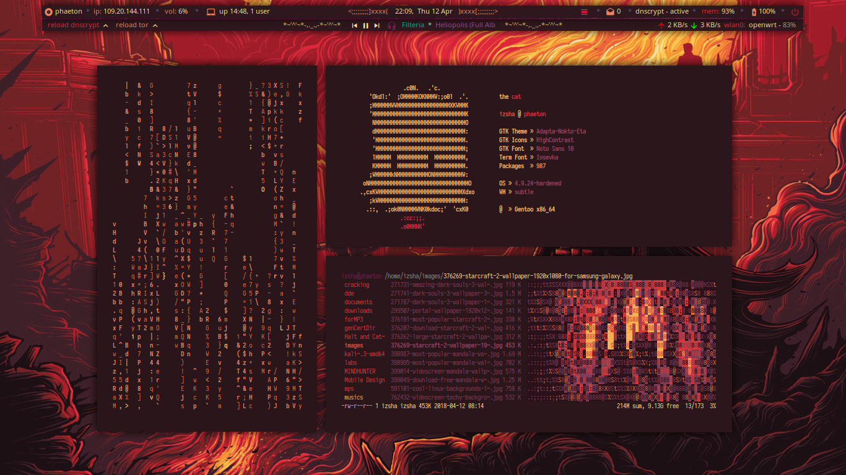
#1 from the past week https://goo.gl/xvhVGY

Slide 10
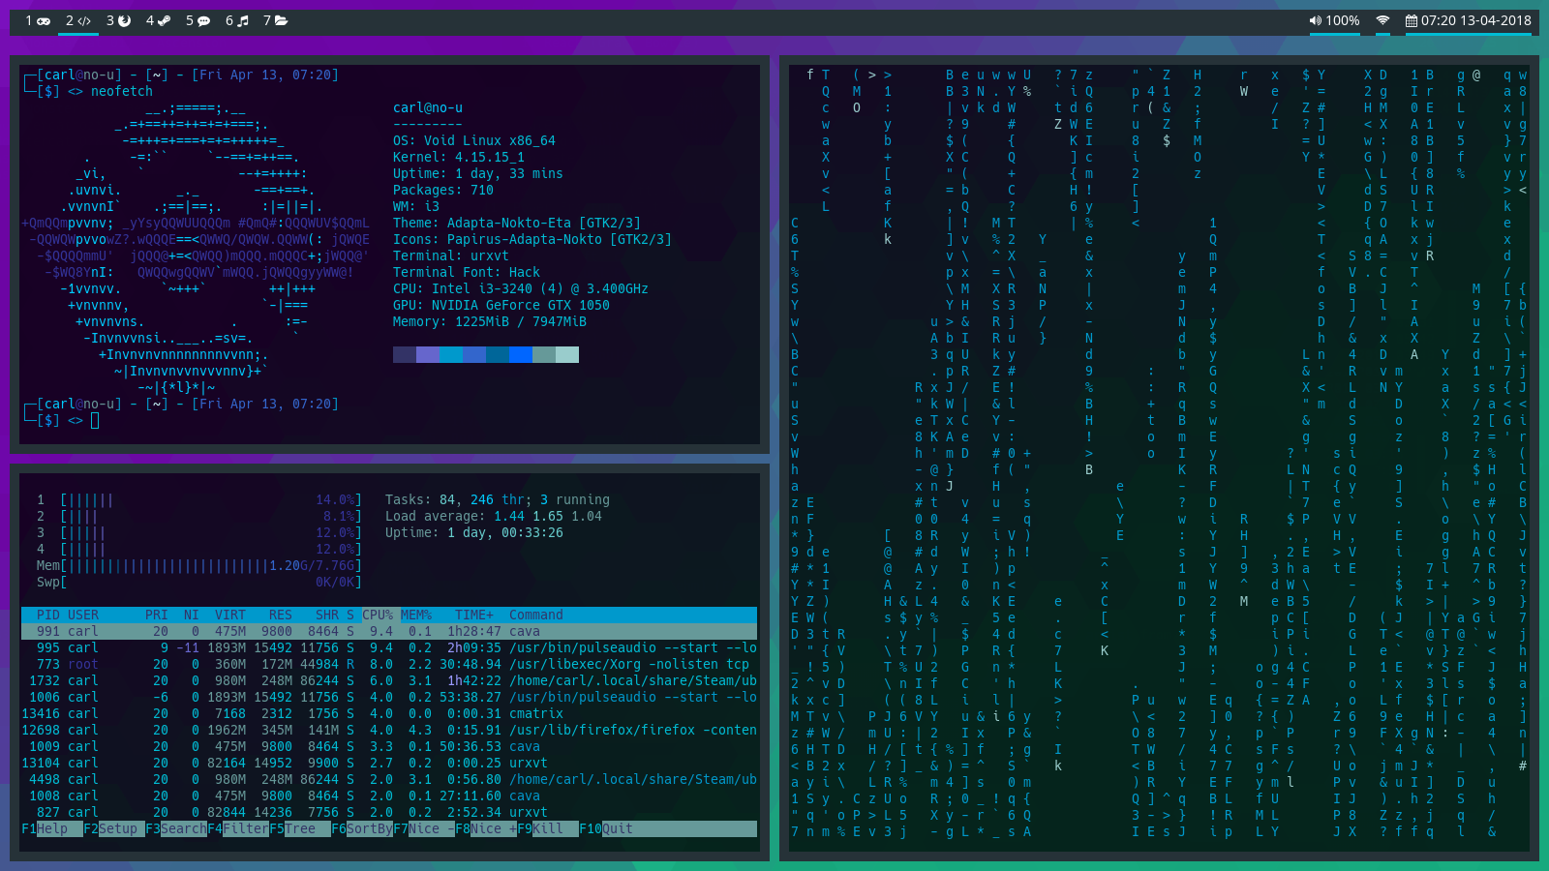
My favorite from the past week https://goo.gl/tBvj2V

Slide 11
What fun thing did you do
this week?
What did you break?

Slide 12
Presentation!
LXC!

