Slide 1
MTU LUG
General Meeting
2018/03/21

Slide 2
Announcements
New Meeting Time
  Wednesday @ 8 in Rekhi G009

Slide 3
eBoard Updates
Pres update
VP update
Server Team update

Slide 4

Join on Involvement
https://www.involvement.mtu.edu/organization/lug

Slide 5

Join lug-l
Join us on;
Slack mtulug.slack.com
  Use mtu email
IRC
THESE ------------------>

Slide 6

Shell Server
Account if
  have been to three general meetings
shell.lug.mtu.edu

Slide 7
/r/unixporn picks of the week

Slide 8
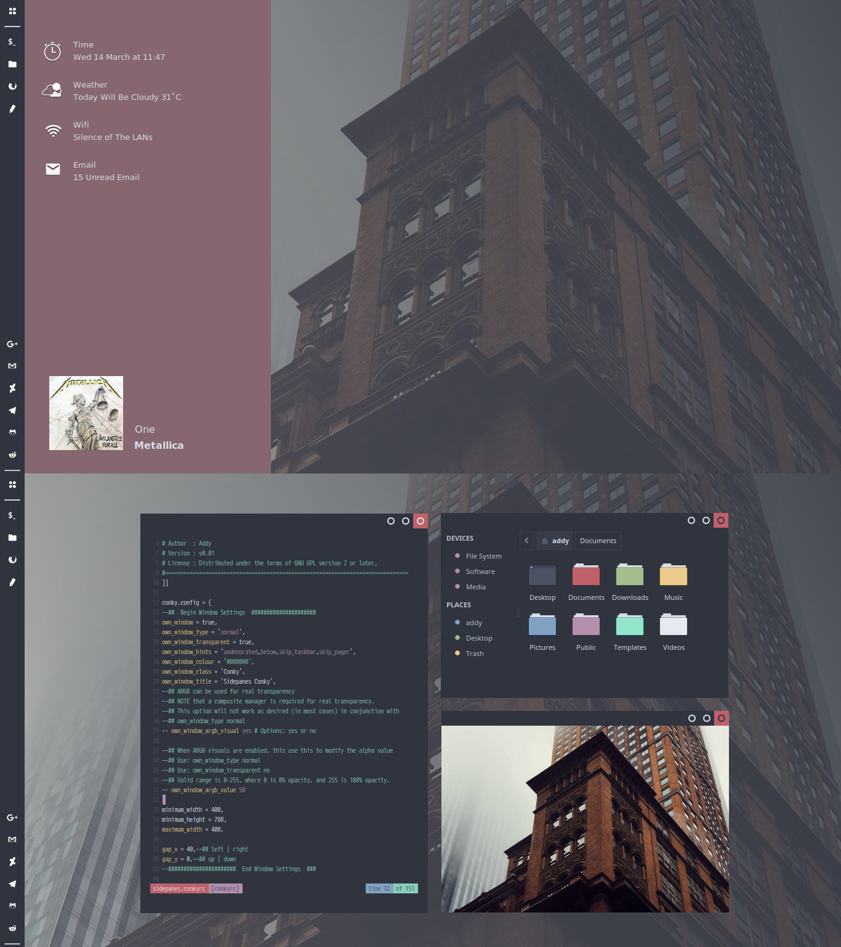
#1 from the past week
https://goo.gl/cJVvou

Slide 9
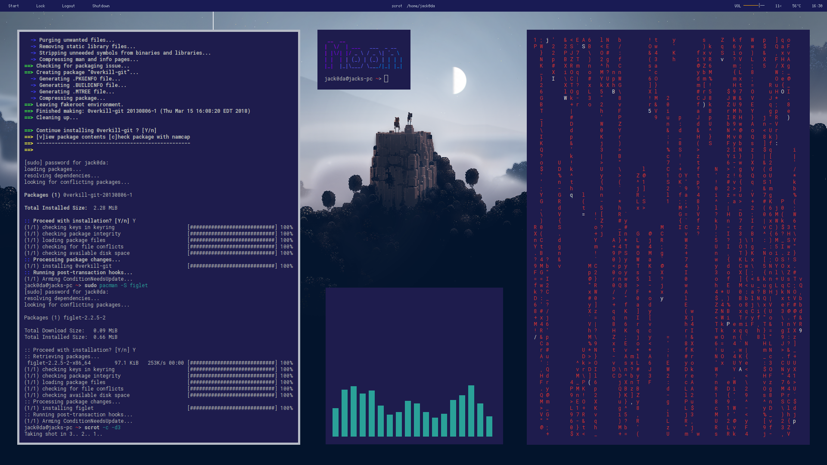
My favorite from the past week
https://goo.gl/6isDXR

Slide 10
What fun thing did you do
this week?
What did you break?

