Slide 1
MTU LUG
General Meeting

Slide 2
Announcements
Continue thinking about elections
  Pres, VP, Server Admins (all?), secretary?, maybe treasurer?
Will be working with a CS professor who is interested in Linux
Nanocon? (still here)
  nanocon-l@mtu.edu
  Wednesday 6PM -- Fisher 131

Slide 3
eBoard Updates
Pres update
VP update
Server Team update
Need to Get the Reimbursement check from MUB
  Jake (if he is even here)
Do we need reimbursements for this past year?

Slide 4
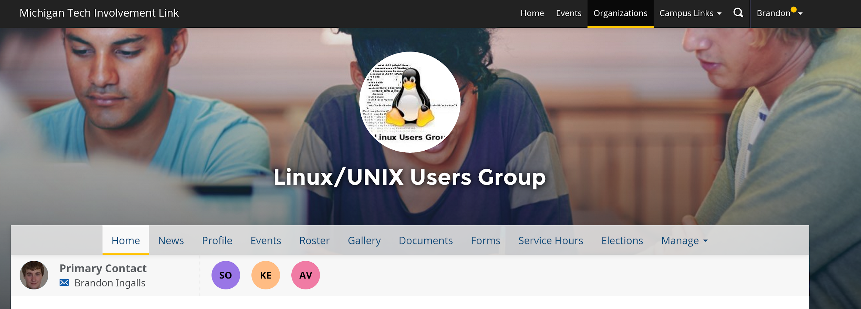
Join on Involvement
https://www.involvement.mtu.edu/organization/lug

Slide 5

Join lug-l
Join us on;
Slack mtulug.slack.com
  Use mtu email
IRC
THESE ------------------>

Slide 6
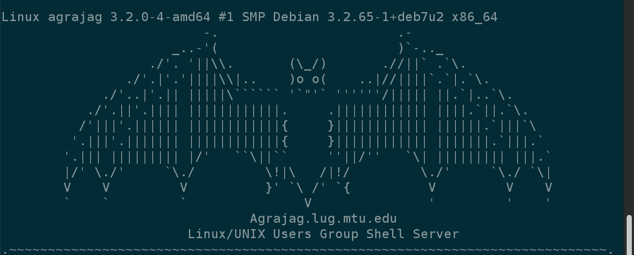
Shell Server
Account if
  have been to three general meetings
shell.lug.mtu.edu

Slide 7
Budget
Final budget allocation of 1200 dollars, they didn't agree with having an emergency fund?

Slide 8
Fun-Time
ZNC bouncer for IRC
What did you break this week or over break
Click Here

