Slide 1
MTU LUG
General Meeting

Slide 2
Announcements
Continue thinking about elections
  Pres, VP, Server Admins (all?), secretary?, maybe treasurer?
SPRING BREAK
Nanocon? (still here)
  nanocon-l@mtu.edu
  Wednesday 6PM -- Fisher 131

Slide 3
eBoard Updates
Pres update
VP update
Server Team update

Slide 4

Join on Involvement
https://www.involvement.mtu.edu/organization/lug

Slide 5
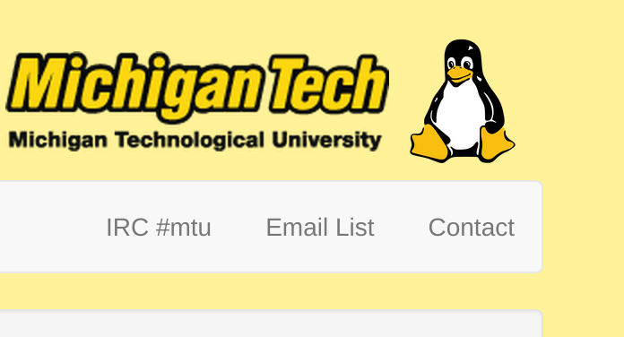
Join lug-l
Join us on;
Slack mtulug.slack.com
  Use mtu email
IRC
THESE ------------------>

Slide 6

Shell Server
Account if
  have been to three general meetings
shell.lug.mtu.edu

Slide 7
Fun-Time
What did you break this week or over break

Slide 8
So Google shows Sha-1 is crackable

Slide 9
What is Sha-1
SHA-1 stands for Secure Hash Algorithm 1
  is a cryptographic hash function designed by the United States National Security Agency
  Is a U.S. Federal Information Processing Standard published by the United States NIST.
    National Institute of Standards and Technology
  SHA-1 produces a 160-bit (20-byte) hash value known as a message digest.
  A SHA-1 hash value is typically rendered as a hexadecimal number, 40 digits long.

Slide 10
Really not that secure
SHA-1 is no longer considered secure against well-funded opponents.
  In 2005, cryptanalysts found attacks on SHA-1 suggesting that the algorithm might not be secure enough for ongoing use
  Since 2010 many organizations have recommended its replacement by SHA-2 or SHA-3.
    Microsoft, Google, Apple and Mozilla have all announced that their respective browsers will stop accepting SHA-1 SSL certificates by 2017.
In 2012 Bruce Schneier, security researcher, reported calculations of Intel researcher Jesse Walker.
  A SHA-1 collision attack will be within the range of organized crime by 2018 and for a university project by 2021. Walker’s estimate suggested then that a SHA-1 collision would cost $2 million in 2012, $700,000 in 2015, $173,000 in 2018 and $43,000 in 2021.

Slide 11
All this is Scary
Not really, On February 23, 2017 CWI Amsterdam and Google announced a practical collision attack against SHA-1, publishing two dissimilar PDF files which produce the same SHA-1 hash as proof of concept.
The reason it's really not that scary is that most large companies, and all the companies stated before stopped using SHA-1
All this info is really just cool and wanted to share with you

