Slide 1
MTU LUG
General Meeting

Slide 2
Announcements
Alright First meeting of the year
Start thinking about elections
Nanocon?
  nanocon-l@mtu.edu
  Wednesday 6PM -- Fisher 131

Slide 3
eBoard Updates
Chris Update
Server Team update

Slide 4

Join on Involvement
https://www.involvement.mtu.edu/organization/lug

Slide 5

Join lug-l
Join us on;
Slack mtulug.slack.com
  Use mtu email
IRC
THESE ------------------>

Slide 6

Shell Server
Account if
  have been to three general meetings
shell.lug.mtu.edu

Slide 7
Fun-Time
What did you break this week or over break

Slide 8
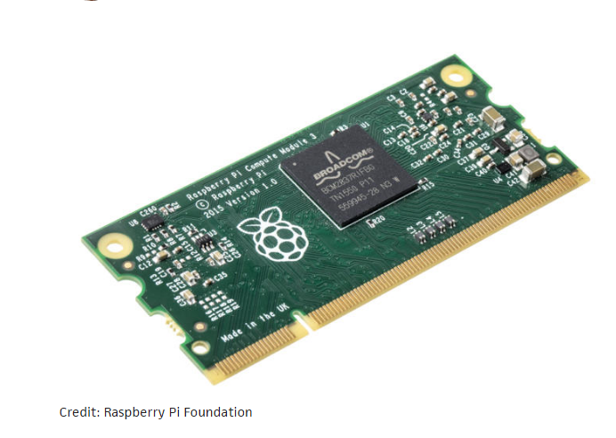
Presentation
Raspberry Pi Compute Module 3!
  Designed with the intention of being integrated
  4 core, 64 bit BCM2837
  1GB of Ram
  No ethernet and no wifi
  But the signals for the ports are still there
    Allowing ultimate design
30 bones
Here is the Link

Slide 9
Questions?
Any questions?

