Slide 1
MTU LUG
General Meeting

Slide 2
Announcements
Career fair this coming Tuesday
  Who is all going
  Anyone need resume help?
Nanocon?
  nanocon-l@mtu.edu
  Wednesday 6PM -- Fisher 131

Slide 3
eBoard Updates
President is doing re registration stuff
  I believe all that is left is the checklist
  All canvas stuff done (maybe)
Positions have been filled
  Alex your emails can now go to the list for minutes and things
Server Team update
  What services should we host
  What mirrors should we host
Any eBoard positions that need the floor

Slide 4

Join lug-l
Join us on;
Slack mtulug.slack.com
  Use mtu email
IRC….
THESE ------------------>
If anyone doesn’t know how to join the list let us know now

Slide 5
Tonight’s Quick Topic
Linux on Windows is still super borked
  Running #ls breaks pulls everything in not a nice way
Brennan Lautner will be presenting on VIM
|
|
V
If you have a topic you want to cover let us know

Slide 6
Fun-Time
T-shirts?
  Anyone have any designs or design ideas
What did you break this week
  Broke my server
Okay presentation time (hopefully)

Slide 7
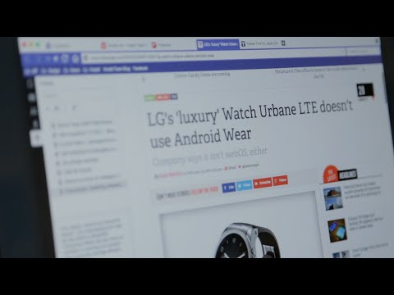

SOOOOooo Vivaldi

Slide 8
Questions?
Any questions?

