Slide 1
MTU LUG
General Meeting
2016-03-18

Slide 2

Join lug-l

Slide 3
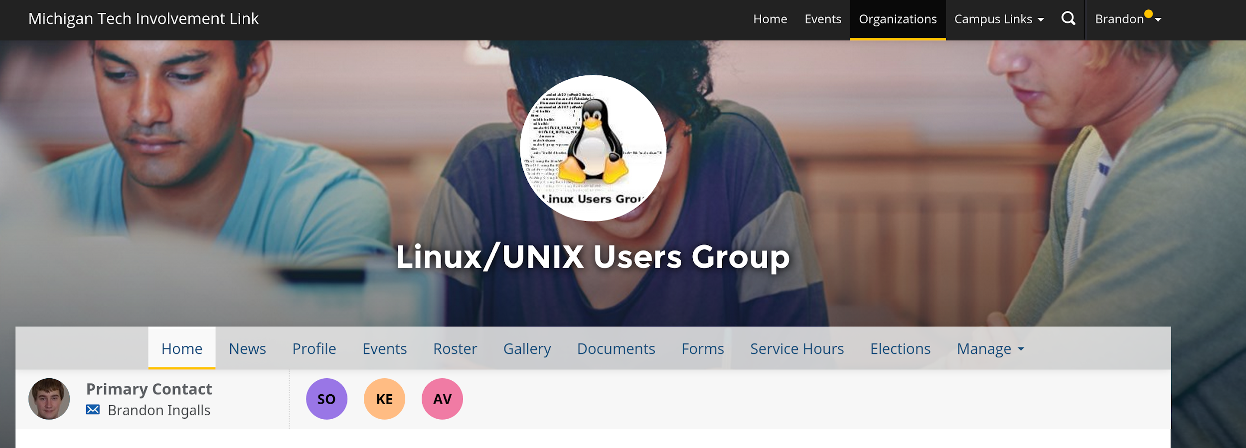
Join on Involvement
https://www.involvement.mtu.edu/organization/lug

Slide 4
Announcements
Elections are Next Week
  2016-03-25
Shell Server is alive!!!
  shell.lug.mtu.edu
  need account?: lug-server-admins-l@mtu.edu
Data Recovery
  Of old shell data
  Kind of

Slide 5
LUG eBoard Elections
We need to have…
  These
    President
    Vice-President
    Treasurer
    Secretary
  To remain a student org and continue to provide our services
Please nominate yourself / another member of LUG
  http://goo.gl/forms/nwUs0f7xEK

Slide 6
Recovered Data
56G of data “in-use” before fsck
26G not “corrupt”
Files contain incorrect data…
  At times
  /home/blingall/.ssh/config -> binary blob, not text config file
  /home/blingall/.ssh/authorized_keys -> all good
Want something from the old shell server
  Email
    blingall@mtu.edu
    lug-server-admins-l@mtu.edu

Slide 7
Users Forum
https://mtulug.slack.com/

