Slide 1
MTU LUG
General Meeting
2016-02-19

Slide 2

Join lug-l

Slide 3
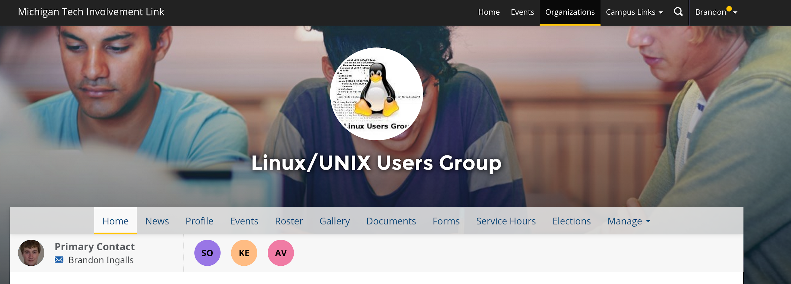
Join on Involvement
https://www.involvement.mtu.edu/organization/lug

Slide 4
Announcements
Shell Server is still currently down
  We have the drives
  Waiting on the Server Admins to rebuild
  Soon

Slide 5
Users Forum
https://mtulug.slack.com/

Slide 6
Presentation: LUKS

