Slide 1
MTU LUG
General Meeting
2016-01-29

Slide 2

Join lug-l

Slide 3
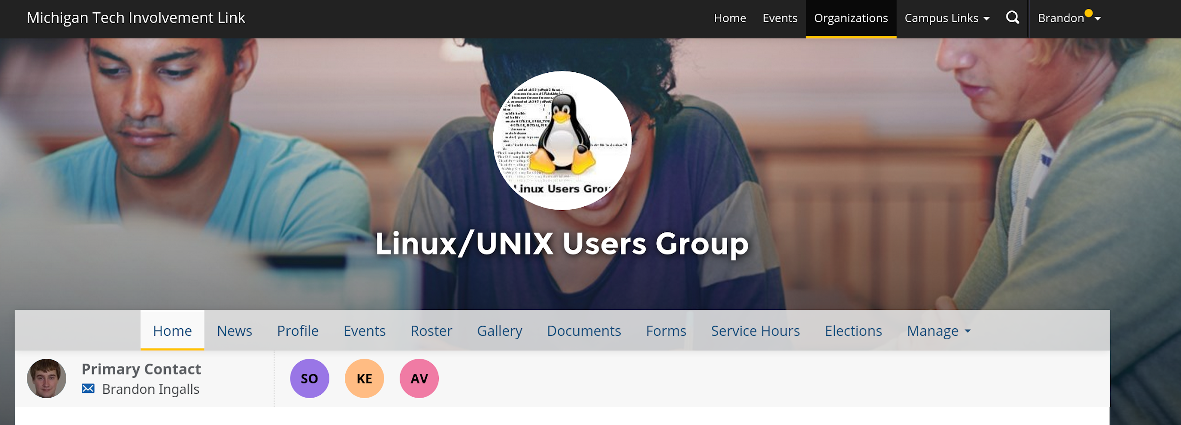
Join on Involvement
https://www.involvement.mtu.edu/organization/lug

Slide 4
Announcements
Shell Server currently down
  Looking to move it to a physical box we acquired
    Need new disks for that
We need a new Secretary
  Nominations?
No meeting next week (2016-02-05)
  Enjoy Winter Carnival

Slide 5
Users Forum
https://mtulug.slack.com/
VMware Workstation / Fusion is kill now?

Slide 6
Presentation: Basic Data Recovery

