Slide 1
MTU LUG
Week 2
General Meeting
2016-01-22
Stephen Radachy (Server Admin) Subbing for Brandon Ingalls

Slide 2
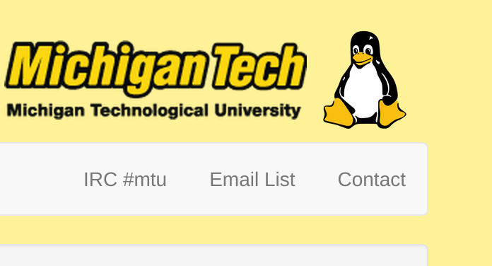
Join lug-l

Slide 3

Join on Involvement
https://www.involvement.mtu.edu/organization/lug

Slide 4
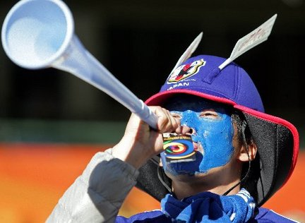
Announcements
Shell Server currently down
  Looking to move it to a physical box we acquired
    Need new disks for that
We need a new Secretary
  Nominations close at the start of next meeting
    January 29th, 2016

Slide 5
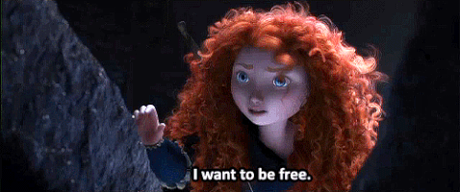
Users Forum
https://mtulug.slack.com/
AT&T Chooses Ubuntu over WinBlows
  http://betanews.com/2016/01/13/att-chooses-ubuntu-linux-instead-of-microsoft-windows/
Former Mozilla CEO releases ad-blocking browser: Brave
  http://www.businessinsider.com/former-mozilla-ceo-brendan-eich-launches-ad-blocking-web-browser-brave-2016-1?op=1
Pressure.JS (JS library for easy force/3D touch integration)
  https://yamartino.github.io/pressure/

Slide 6
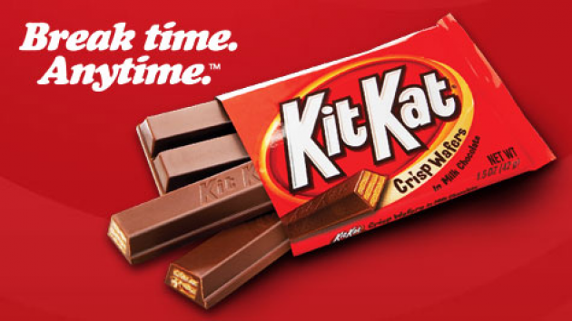
What did you break this week?
Servers?
Code?
Kit Kat?

Slide 7
Presentation: How I deployed wwhack.org

Slide 8
Tech
Digital Ocean
  DNS (Domain purchased through NameCheap)
  Private Networking
(Front-end) Ubuntu 14.04 LTS
  (Web Server) Apache
  (TLS/SSL) LetsEncrypt
  Git
  PHP
(Database) Debian 8.2
  iptables (nftables will be replacing it)
  MySQL

Slide 9
Demo Time!

Slide 10
Next Meeting:
January 29th, 2016
Rekhi 101
5-6pm

