Slide 1
MTU LUG
First Meeting of the year
General Meeting
2016-01-15

Slide 2

Join lug-l

Slide 3

Join on Involvement
https://www.involvement.mtu.edu/organization/lug

Slide 4
Announcements
Shell Server currently down
  Looking to move it to a physical box we acquired
    Need new disks for that
We need a new Secretary
  Alex Roberts went on Co-Op.

Slide 5
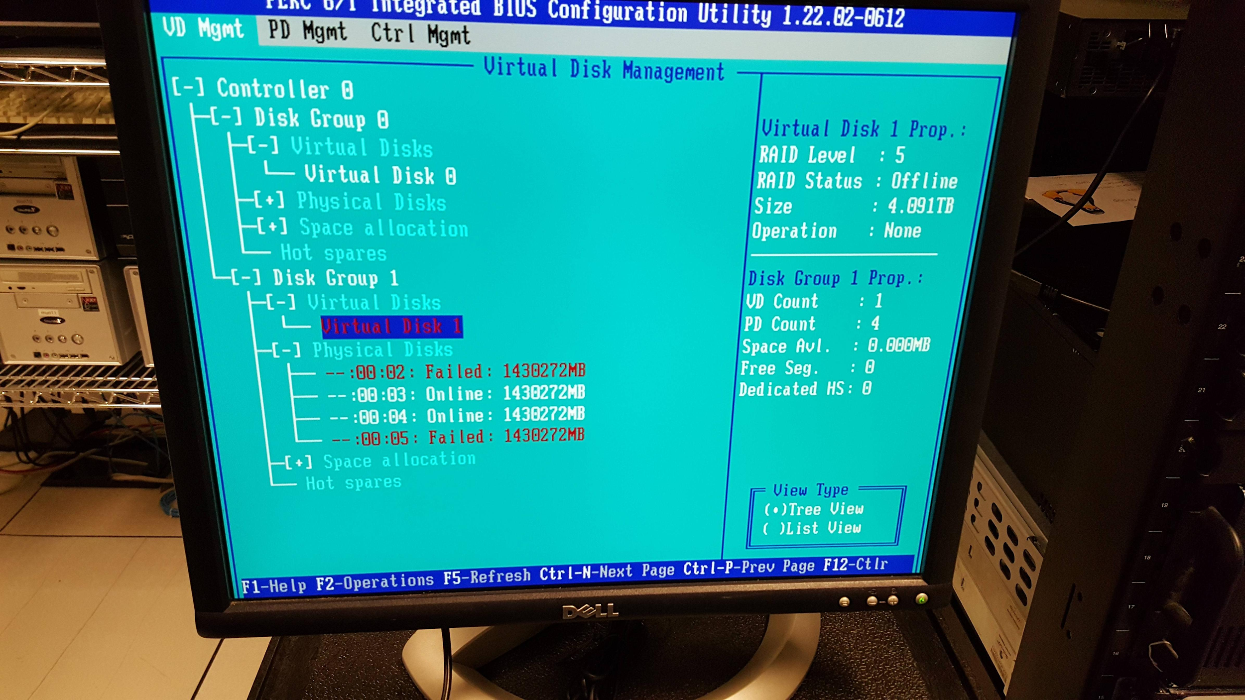
XenServer
Hosted some services
  Shell Server
  HuskyBot
RAID5
  4 disks total
  Can handle 1 failure
  2 disks went offline
    within hours of
    each other
Attempting to recover
  BTRFS sucks terribly!
  My workstation used BTRFS… and it exploded… again...

Slide 6
Vote Alex R out
He is gone on Co-Op
Need to vacate his position
Volunteers to replace him?
  You just jot down some notes on what we talked about during the meeting.

Slide 7
Users Forum
https://mtulug.slack.com/
OpenSSH Roaming exploit
  Dissection of the bug
Linux + DisplayPort = Sucks

Slide 8
Basic Data Recovery

