Slide 1
MTU LUG
General Meeting
2015-11-13

Slide 2

Join lug-l

Slide 3
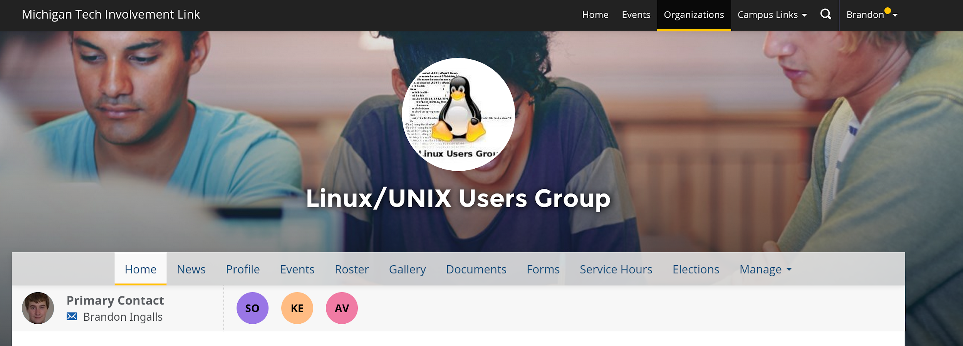
Join on Involvement
https://www.involvement.mtu.edu/organization/lug

Slide 4
Announcements
No meeting 2015-11-20
  This room is still registered to us
    If those who are on campus want to do anything

Slide 5
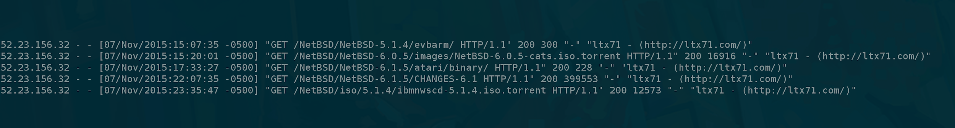
Unused Mirrors
Few unofficial mirrors…
  watching logs for a while now
  For Example…
    cat access.log | grep -E 'GET \/(freebsd|netbsd|FreeBSD|NetBSD)\/'
    Only visitor… Pretty much ever = http://ltx71.com/
Vote to remove FreeBSD and NetBSD from official mirrors ~900G
  For now
  Next semester we can vote as a group to see if we want to become official mirrors…
    Not just copying data from some poor mirror, for no reason

Slide 6
Users Forum
https://mtulug.slack.com/
blingall is starting to learn Ruby
  Hates it so far

Slide 7
Red vs Blue v2 / Reboot
blingall = Red Team
One lucky LUG Member = Blue Team
blingall will hand control of server over to Blue Team
Blue team will give blingall Webmin user with no permissions
  Their downfall

