Slide 1
MTU LUG
General Meeting

Slide 2

Join lug-l

Slide 3
Reminders
Nanocon
  nanocon-l@mtu.edu
  Wednesday 6PM -- Fisher 131
DoD Rep
  Oct 30
Need to start meeting minutes again
  We need a new secretary
    Volunteers?
    Pretty Please

Slide 4
Server Team Updates
Alumni broke in
  Were using MTU/LUG resources for personal reasons
New weekly meeting time
  Right after this meeting
  Working on new policies
Begin an audit of services
  Network Diagram

Slide 5
Users Forum
MTU LUG Steam Group
  See Alec (the guy with the headphones)
https://mtulug.slack.com/

Slide 6
Presentation
Stuff and things

Slide 7
Audio Formats
or, why I love Opus
By Alec Hitchiner

Slide 8
Lossless Audio Formats

Slide 9
Lossless Audio Quality
Same for all formats
Dependent on
  Sample rate (affects frequency response)
  Bit depth (affects noise floor and definition)
Always better than lossy with same sample rate and bit depth
  Difference might not be audible, but is latent in the audio

Slide 10
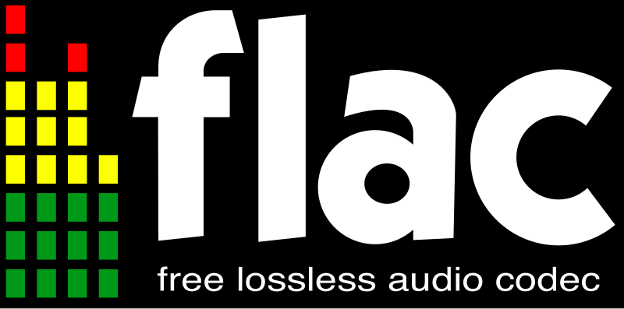
Lossless Audio Formats
WAV
  Uncompressed (huge files)
  Simple
  Used as an interchange format
WAVPack
  Naive compression format
  Poor compression ratios
APE (Monkey’s Audio)
  Closed, proprietary format
  Limited support
FLAC
  Open format
  Good compression ratios
  Well supported
ALAC
  Because Apple

Slide 11
Lossy Audio Formats

Slide 12
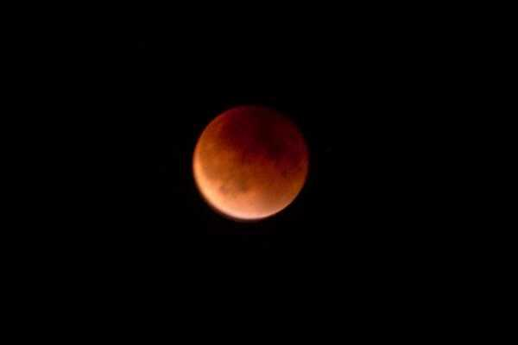
What is lossy compression?
Selective removal of data
  Better compression ratios
  Adjustable file size (quality/memory trade-off)
  Quality dependent on
    Sample rate
    Bit depth
    Codec
    Bit rate
    Encoder
Inherently lower audio quality
  Even at maximum settings
  Quality difference becomes apparent after multiple encodings and in areas with sharp spikes (noise, applause, drum beats, etc.)
Google Docs hates tiff :(

Slide 13

MP3
Mpeg-1 audio layer 3
First released in 1993 (22 years ago!)
Closed format, though open-source encoders exist
Gained massive popularity via the internet
Very widely supported

Slide 14
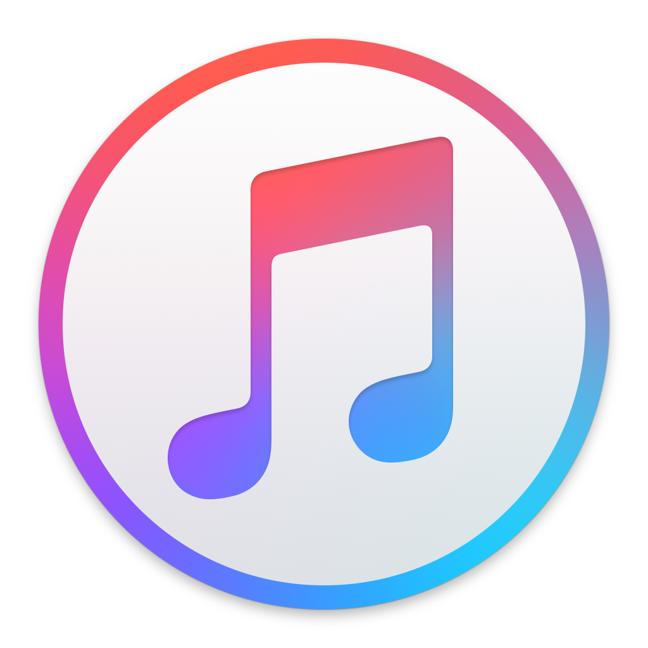
AAC
Advanced Audio Coding
First released in 1997 (18 years ago) as part of the Mpeg-2 standard
Closed, proprietary format. Some open-source encoders do exist, but they suck
Designed to be a successor to Mp3
Initially had better audio quality, better Mp3 encoders have closed the gap
Used by apple for iTunes

Slide 15

Vorbis
First released in 2000 (15 years ago), last updated in 2012 (3 years ago)
Open format
Audio quality about the same as Mp3 (debatably higher)
Relatively widely supported on newer devices
Created by the Xiph.Org Foundation (also created FLAC, Opus, Icecast, etc.)

Slide 16

Opus
Released in 2012 (3 years ago)
Open format
Designed for use in VoIP systems
Very low encoder lag (down to 5ms)
Much higher audio quality than Mp3 at the same settings
Retains definition even when pushed to very low bitrates
Not very widely supported
  Most desktop media players have support
  Android added support in 5.0*
  Rockbox has support

Slide 17
DEMO TIME!

