Slide 1
MTU LUG
General Meeting

Slide 2

Career Fair
How did y’all do?

Slide 3
Announcements
Nanocon
  nanocon-l@mtu.edu
  Wednesday 6PM -- Fisher 131

Slide 4
eBoard Updates
Career Fair
DoD Rep
  Next Friday?

Slide 5

Join lug-l

Slide 6
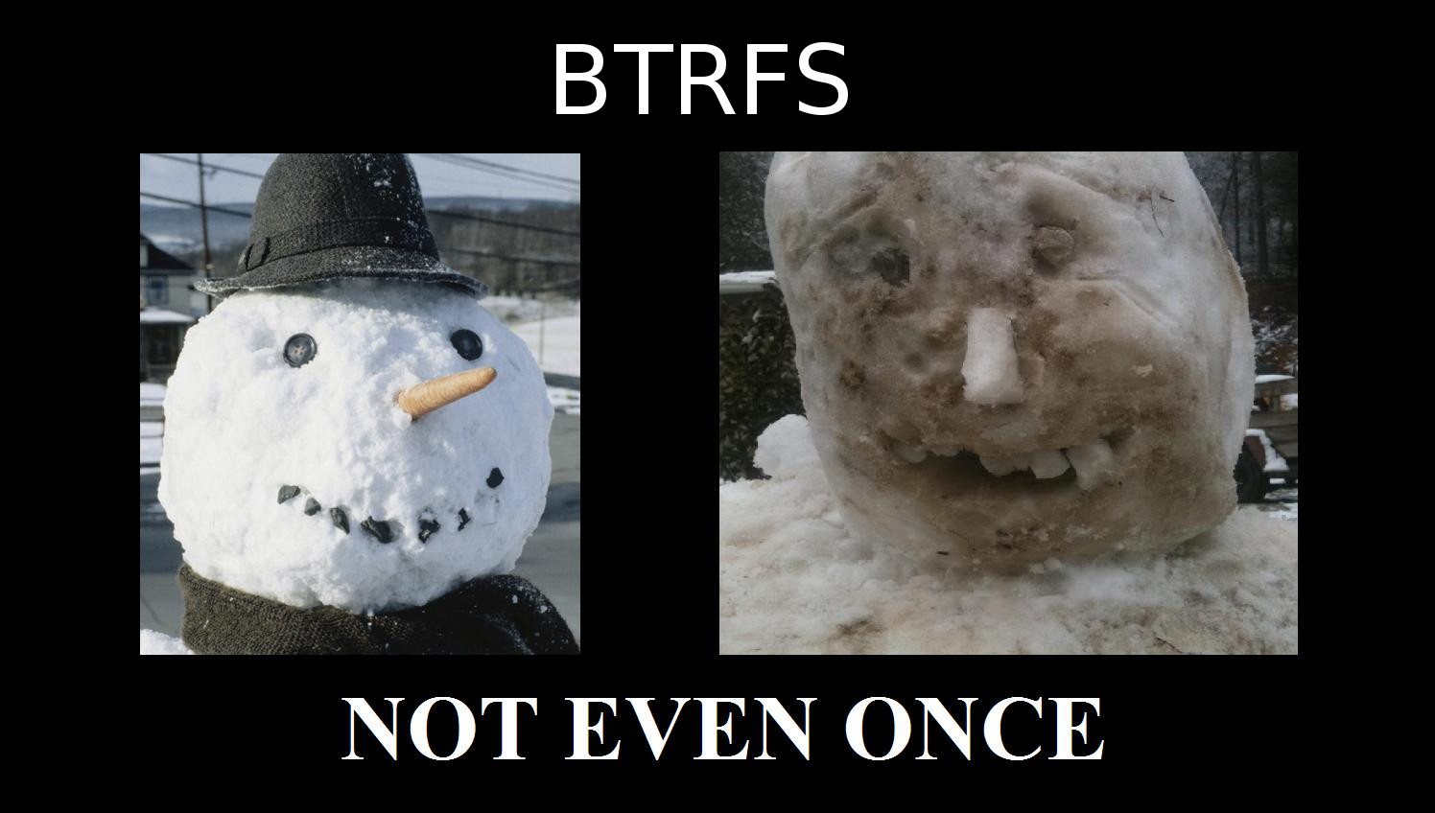
BTRFS Warning
Dev / Fun only
Last Meeting
  Demo Gods were not with me
Backups Backups Backups
  Backups Backups Backups
  Backups Backups Backups
  Backups Backups Backups
  Backups Backups Backups
  Backups Backups Backups
  Backups Backups Backups
  Backups Backups Backups
  Backups Backups Backups
  Backups Backups Backups
  Backups Backups Backups

Slide 7
Website Re-Working
https://github.com/lug-mtu/Web2.0
Brian you my MVP

Slide 8

Users Forum
What’s up?
ITOxygen
Narcos
Soma
  GOTY

Slide 9
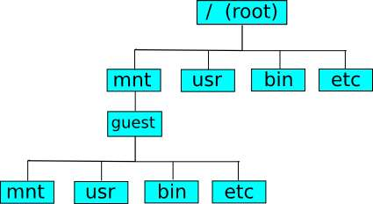

“Quick” Demo
Building a RPM

Slide 10
Final Questions?

