Slide 1
MTU LUG
General Meeting

Slide 2
Career Fair
“Short” Meeting
  Getting a job is important

Slide 3
Announcements
Center for Technology & Training
  10-15 hours / week
  C & SQL prefered
  Dillman 305
  gschlaff@mtu.edu
Nanocon
  nanocon-l@mtu.edu
  Wednesday 6PM -- Fisher 131

Slide 4
eBoard Updates
Investigate migrate mirrors to dedicated host
Small talk from our DoD rep?

Slide 5

Join lug-l

Slide 6
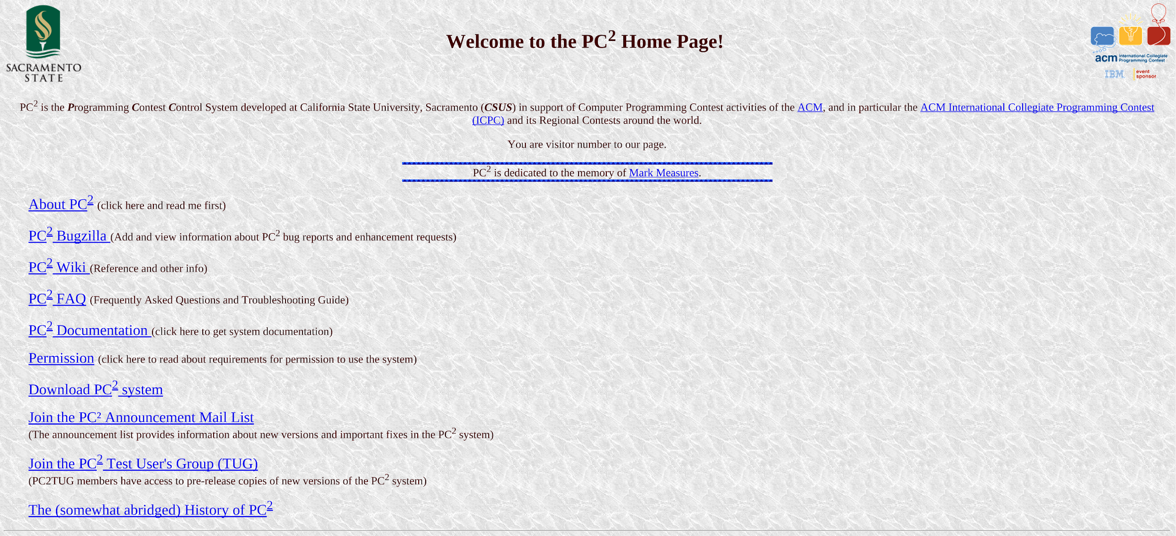
Users Forum
blingall
  PC^2

Slide 7

Tonight’s Quick Topic

Slide 8
Why Use Docker?
Cross-Platform
  Windows
  OS X
  Linux
  BSD ← Little janky
Git like
  Commit your work
  Share with others
Develop & Host in the same place

Slide 9
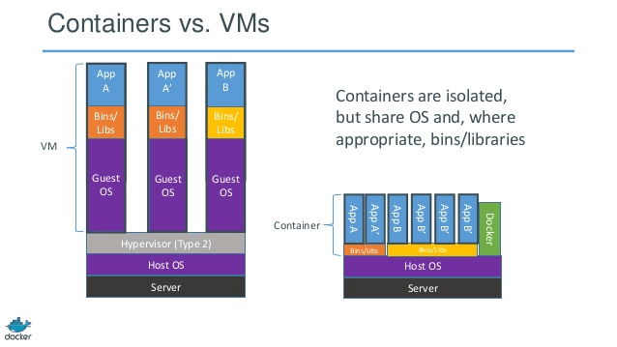
What is a container?

Slide 10
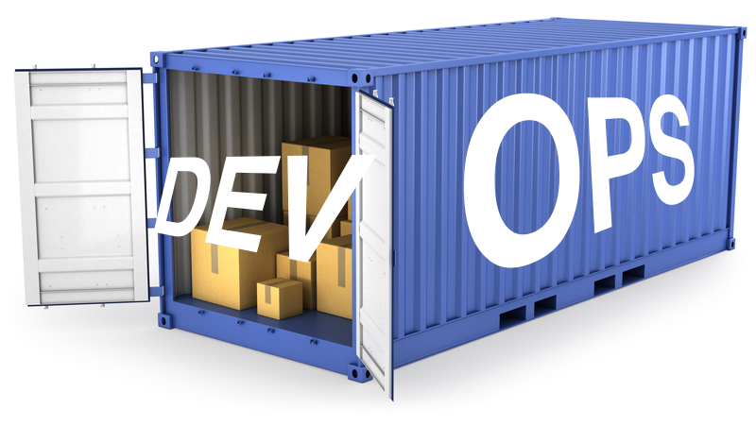
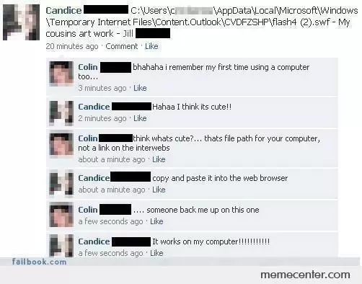


Your setup works on all machines

Slide 11
Fun-Time

Slide 12
Questions?

