Slide 1
MTU LUG
General Meeting

Slide 2
eBoard Updates
Re-register the LUG with the school
  eBoard please see Brandon after meeting

Slide 3
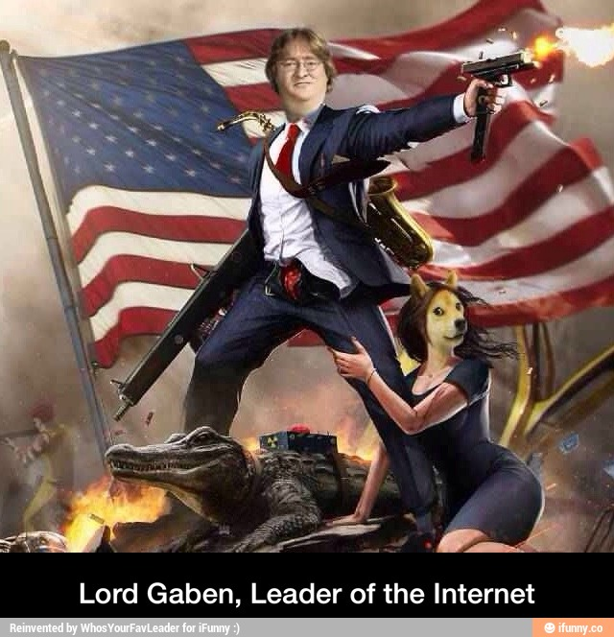
eBoard Introductions

Slide 4

Advertising
Share our existence with EVERYONE
Class Visits
  What classes should we hit?
Table Tents?
Posters?

Slide 5
Clean lug-l
Currently have 187 “people”
  Non-existent
  Unused emails
  Etc
Will send out email / survey
  Wait 2 weeks
  #ThePurge

Slide 6

Join lug-l

Slide 7

Website Redesign
Current version hurts…
Good at WebDev?
  Email blingall@mtu.edu -- Bling All
    As in… Look at all that bling

Slide 8

Users Forum
blingall
  Amazing program - SAS

Slide 9
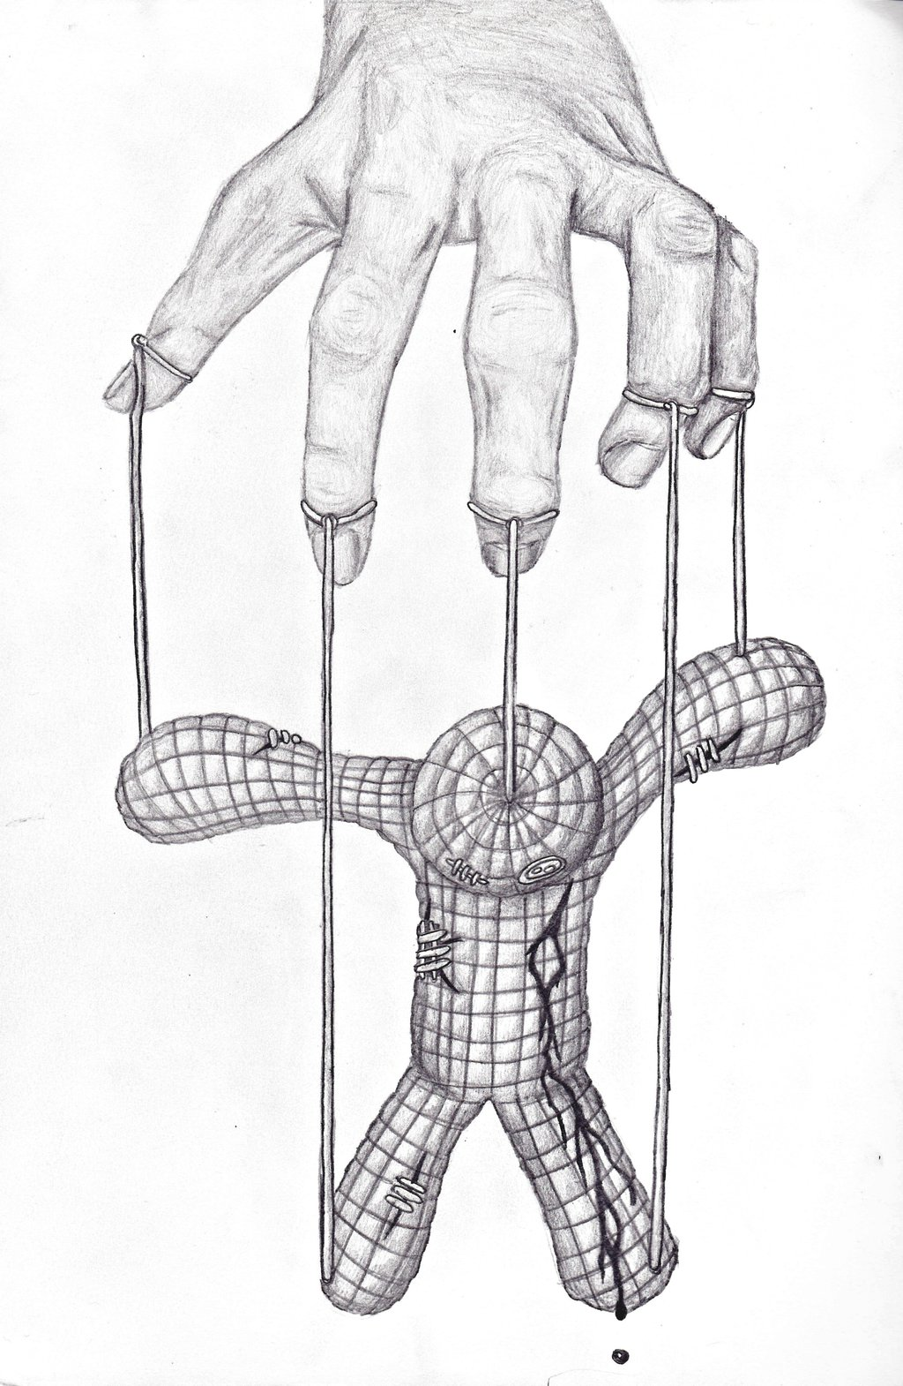
Tonight’s Topic….
Puppet
  Sneak Peak

Slide 10
What?
Agent
  Installed on client
Master
  Central (sometimes) server

Slide 11
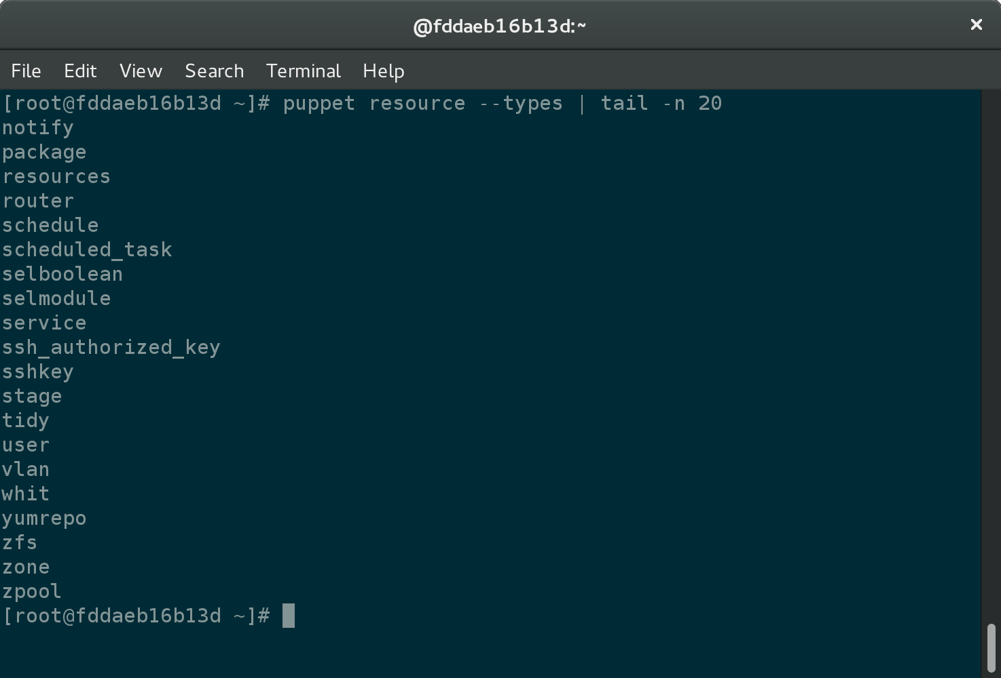
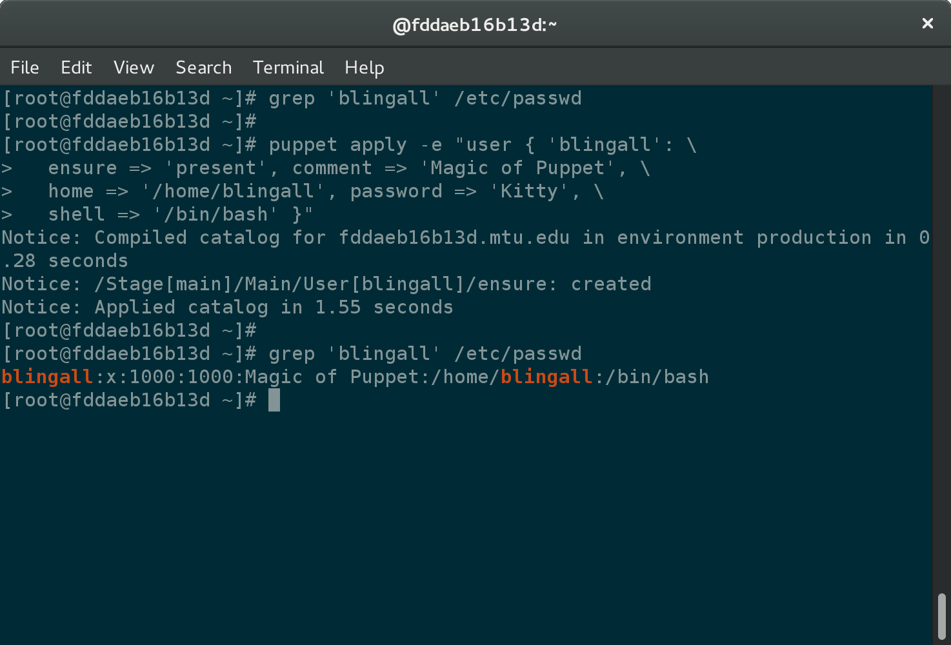
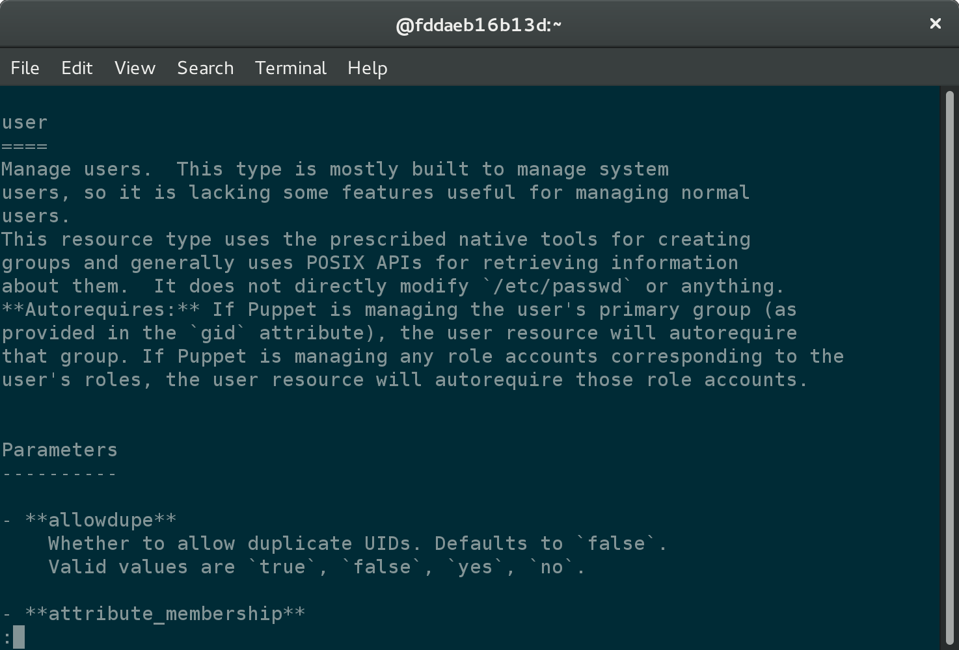
Agent & Resources
$ puppet apply -e "user { 'blingall': \
ensure => 'present', comment => 'Magic of Puppet', \
home => '/home/blingall', password => 'Kitty', \
shell => '/bin/bash' }"

Slide 12
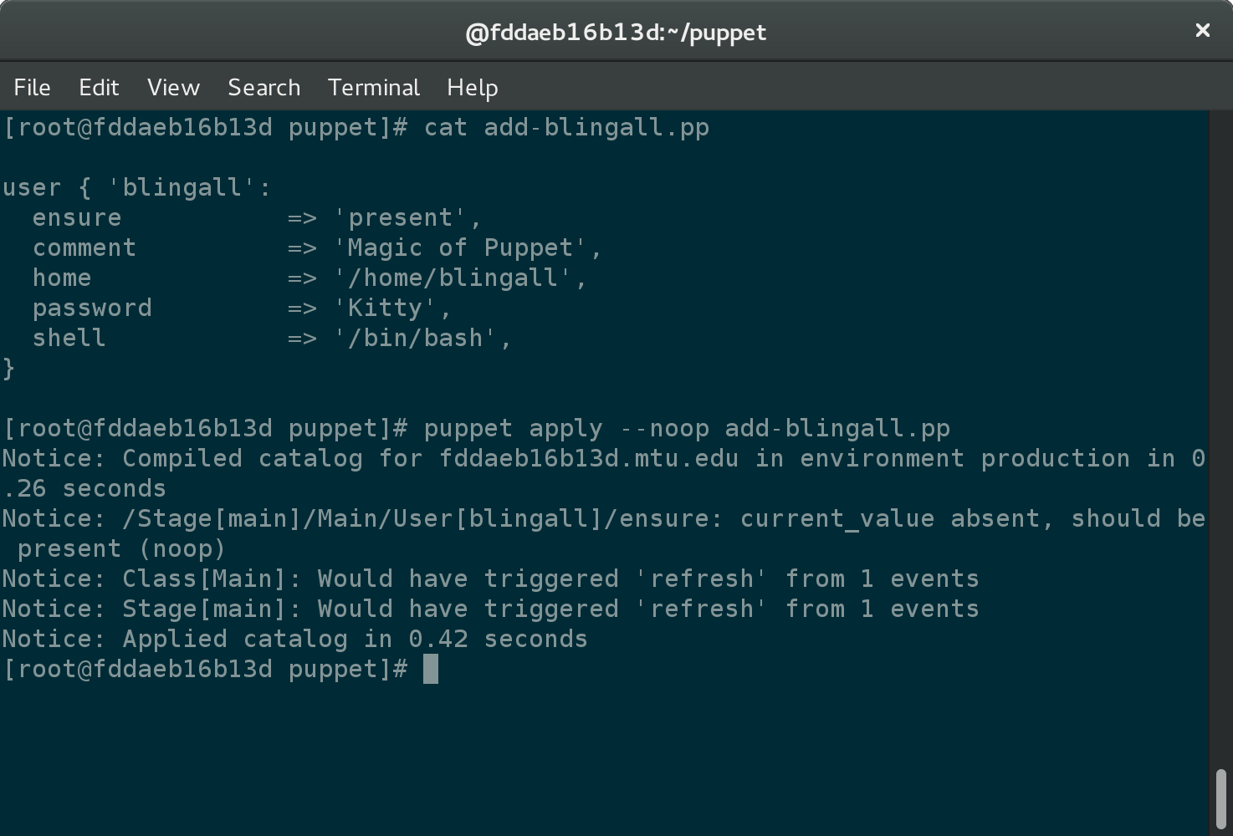
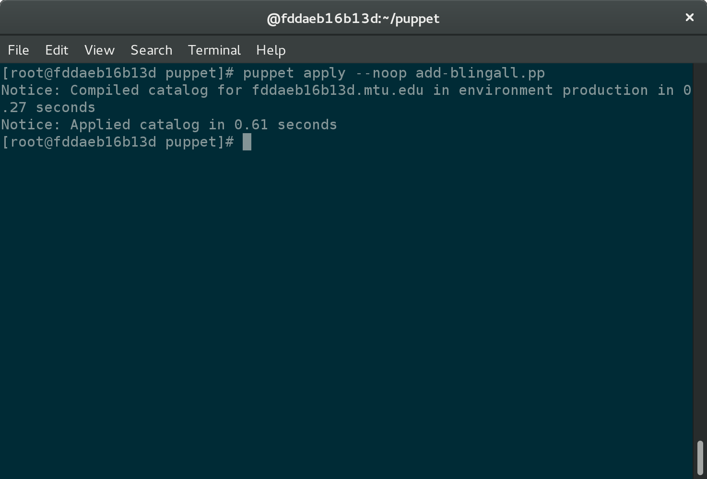
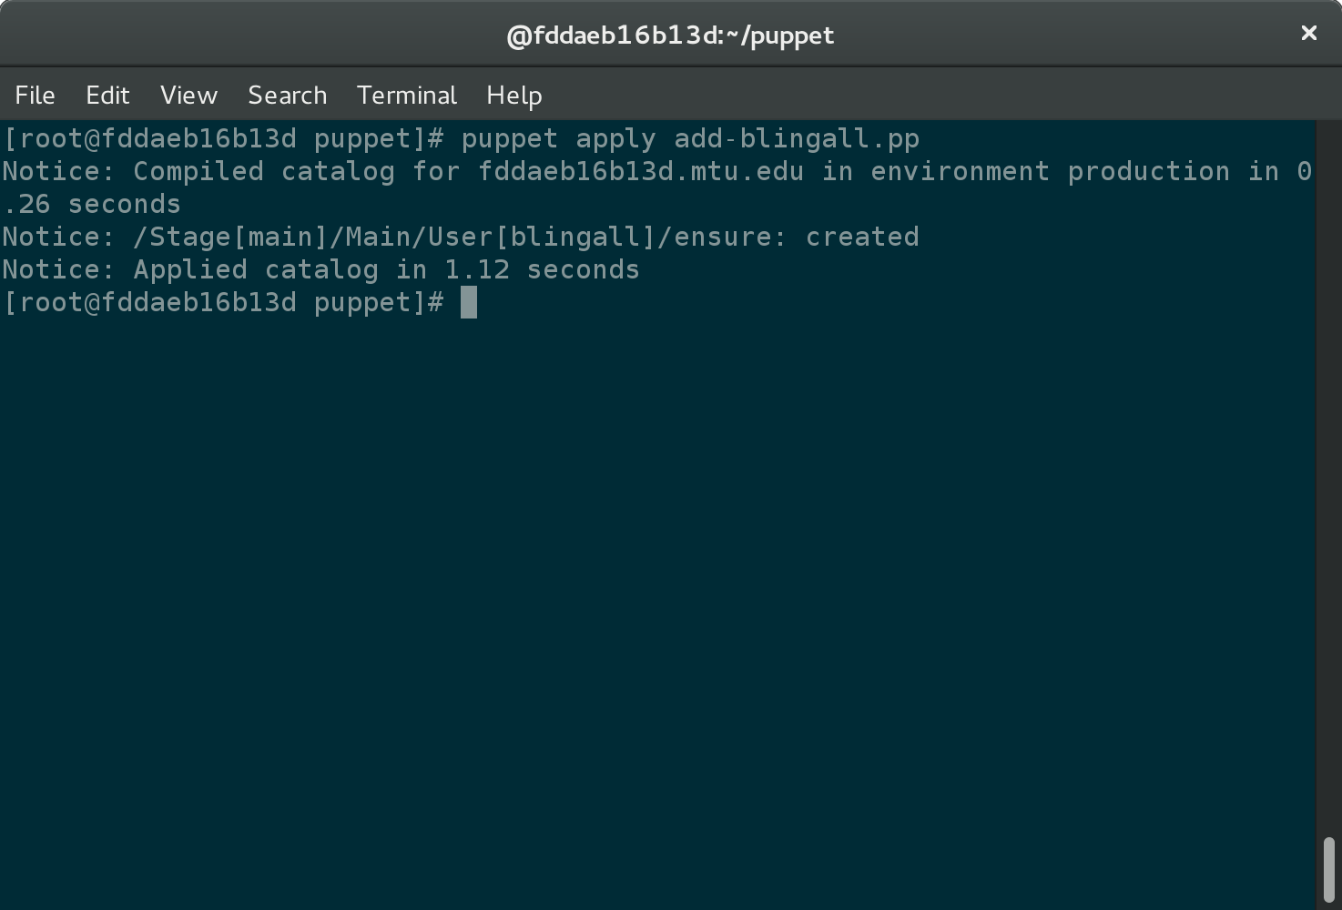
Manifests

Slide 13
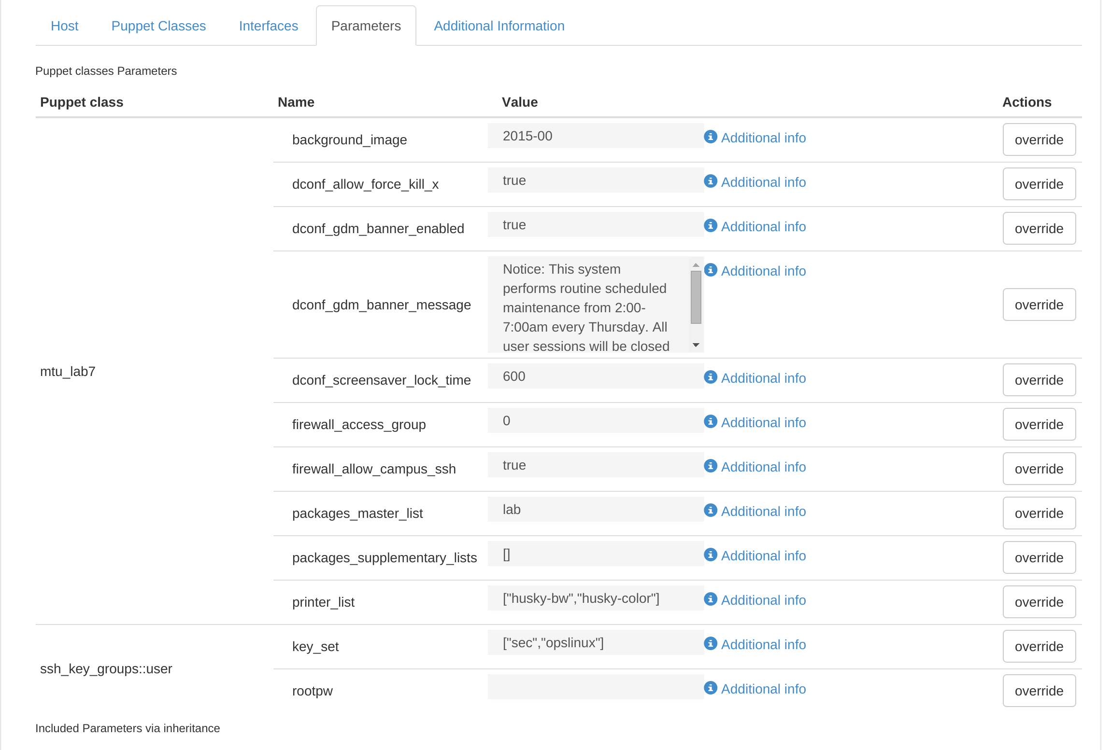
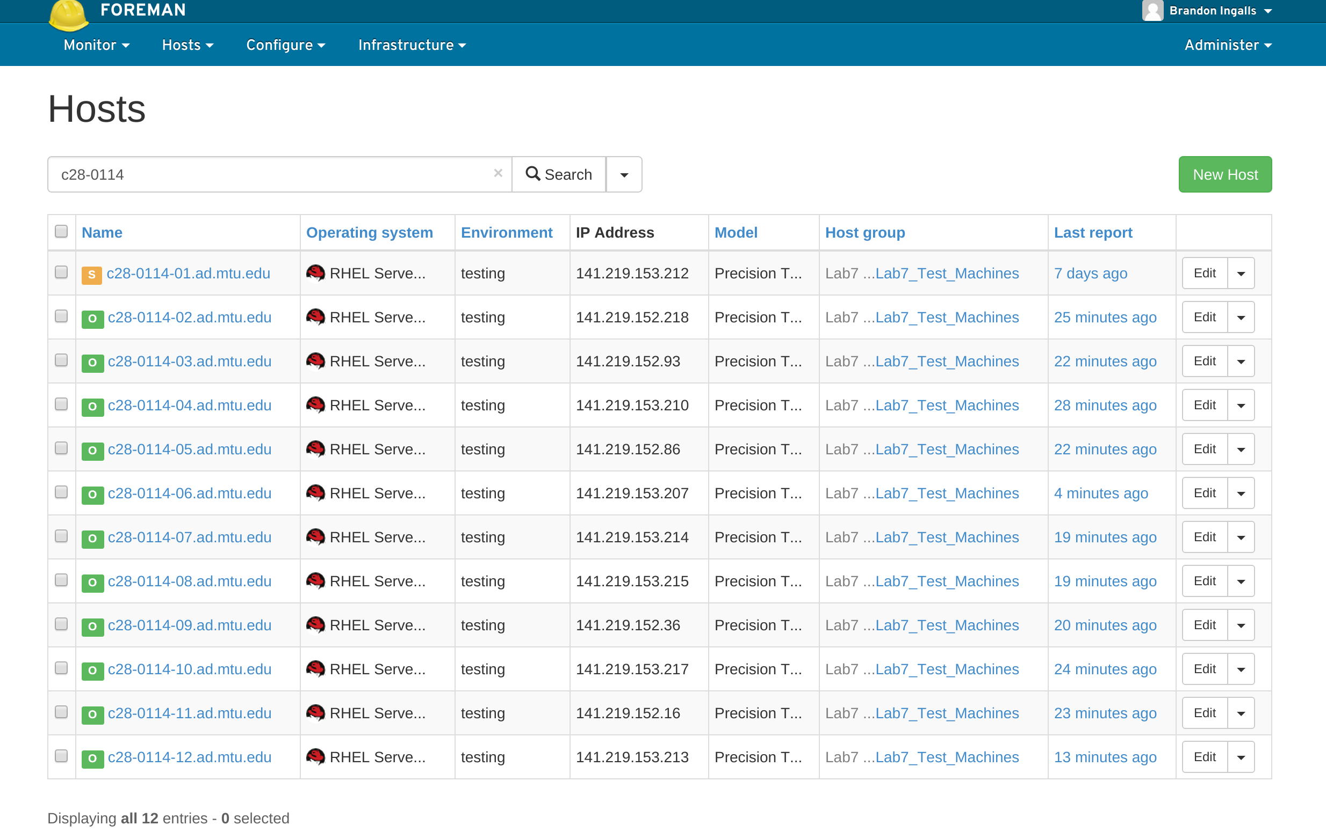
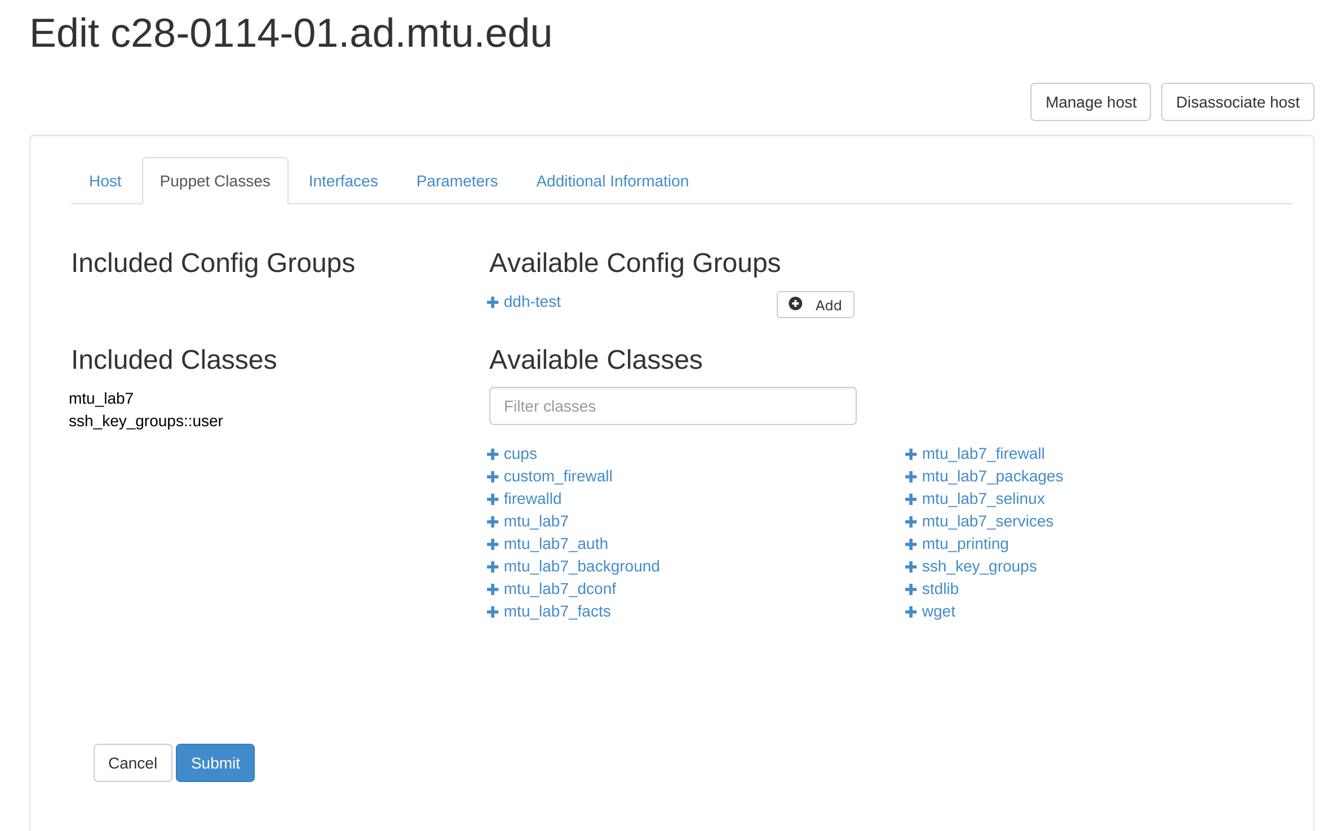
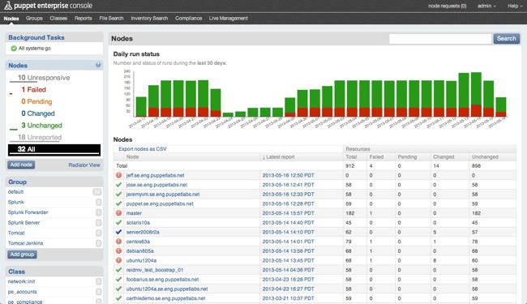
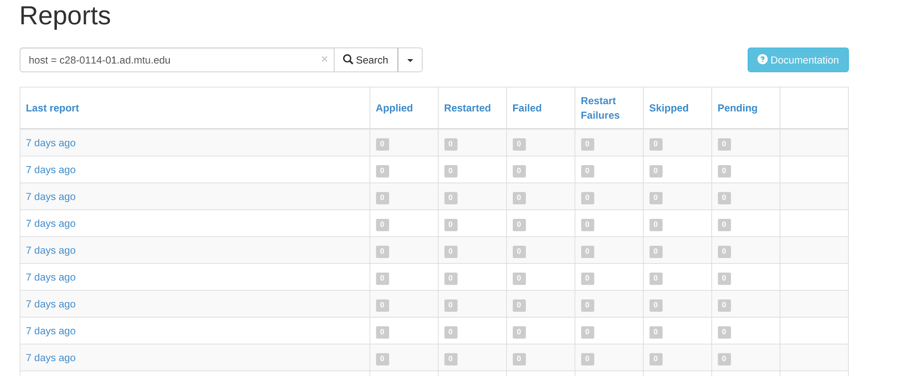
Master
Puppet Enterprise Console
Foreman

Slide 14
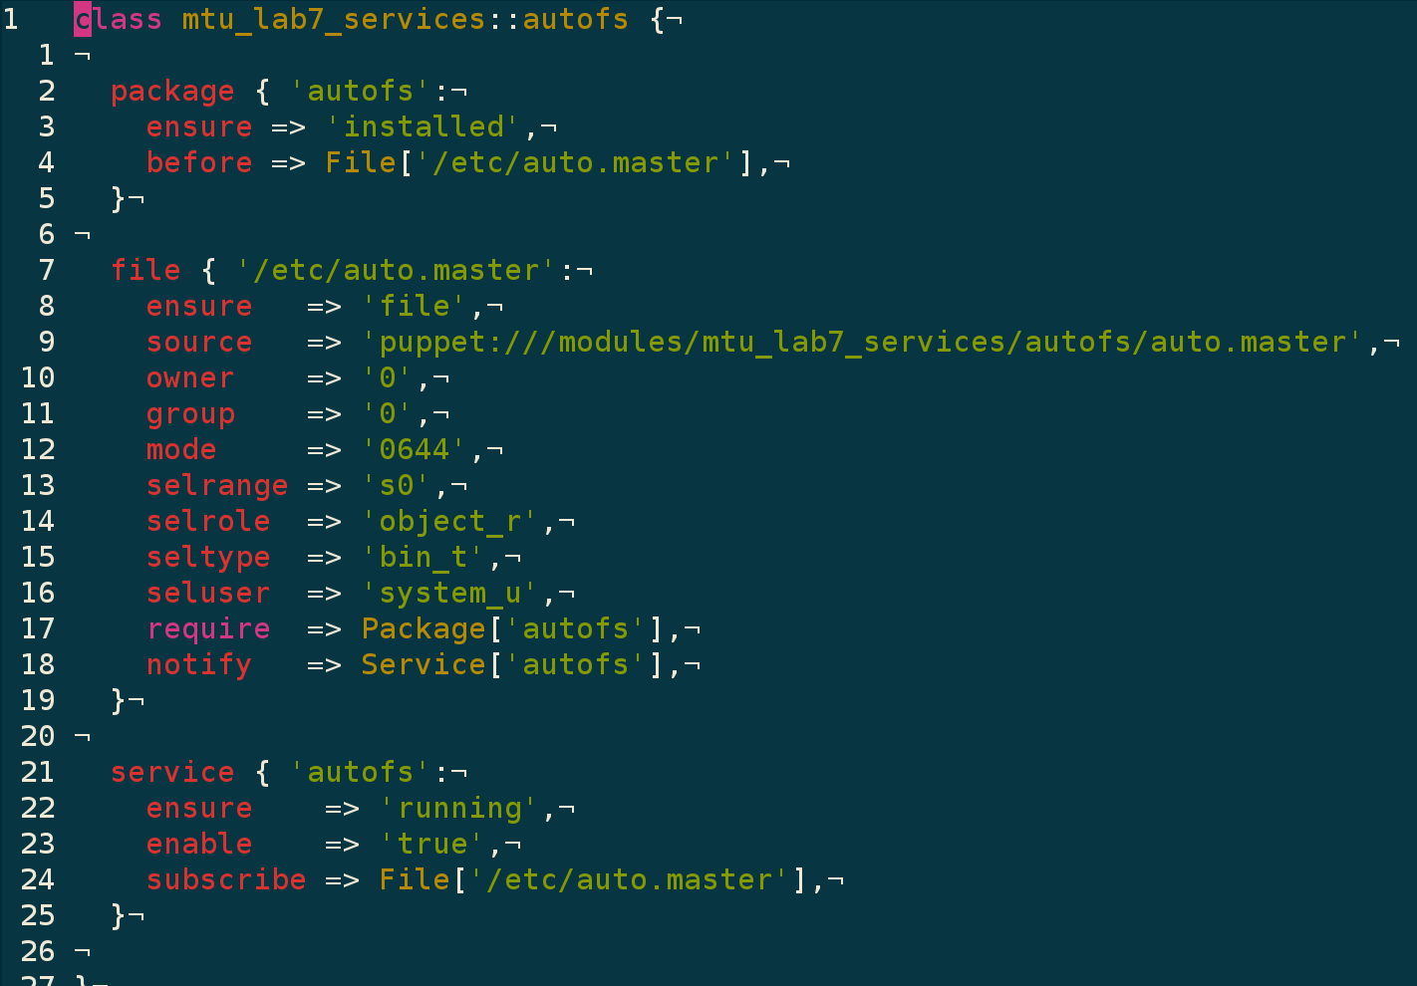
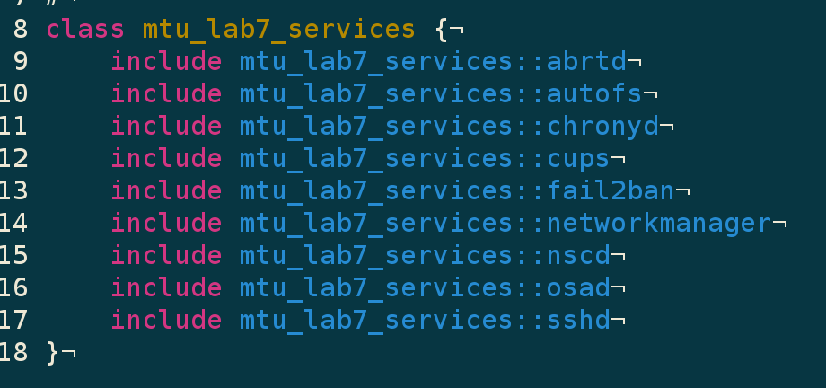
Master - Manifests

Slide 15
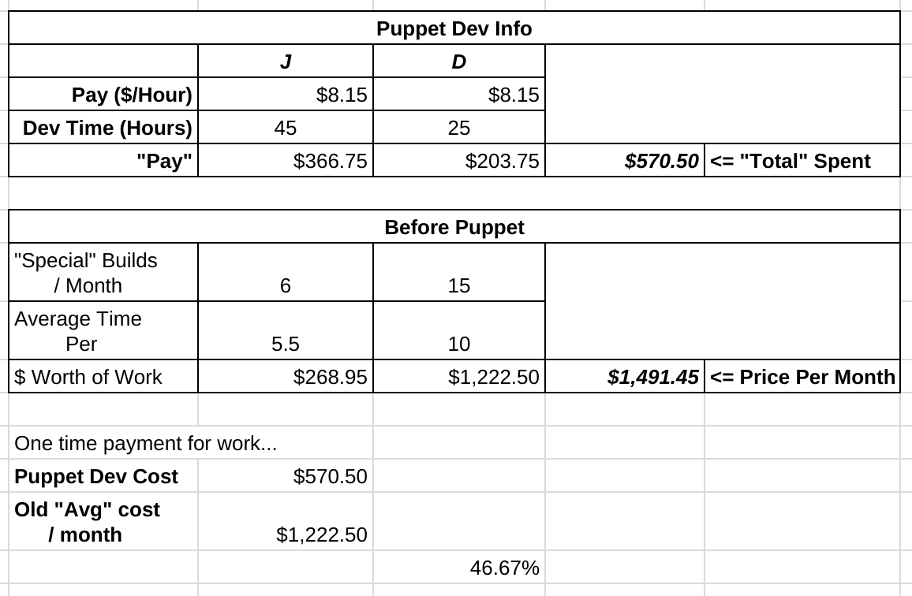

Importance? Time and ???

Slide 16
Questions

