Slide 1
MTU LUG General Meeting
October 14th, 2014

Slide 2
Meeting Agenda
Server Status
Logstash! :: lug.mtu.edu/kibana/
Future Presentations

Slide 3
MTU LUG Services

Slide 4
We Provide:
User Knowledge Base (Wiki)
Public SSH Server
Internet Chat Relay (IRC)
Project VM Hosting
Mirrors, Mirrors, and More Mirrors

Slide 5
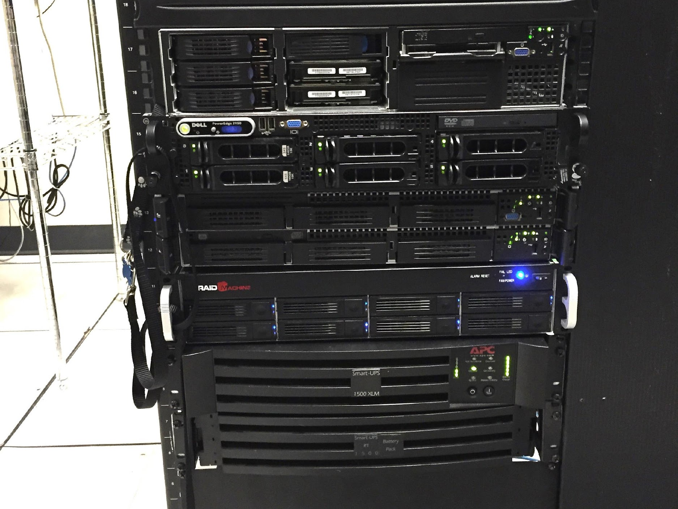
Osiris
Trillian
Zaphod
Archive
RAID Array
UPS

Slide 6
Wiki :: lug.mtu.edu/wiki/
All past and current members can get accounts
Collection of random knowledge

Slide 7
SSH Server :: ssh.lug.mtu.edu
Available to all past and current members
User website @ shell.lug.mtu.edu/~username
Great for hosting userspace services
Software requests

Slide 8
IRC :: irc://lug.mtu.edu
USLUG Network (uslug.org)
3 node setup (NMU, MTU, & USLUG)
Many Alumni chill in #mtu
Great for quick answers

Slide 9
VM Hosting :: trillian.lug.mtu.edu
Any member can request a virtual machine
Only privately accessible via SSH Server
Good for project testing
Free

Slide 10
Mirrors! :: lug.mtu.edu
Most heavily used service
Mirrors 14 Distributions
Accessed 200-1000+ per minute
100Mb/s download & upload

Slide 11
How We Mirror
Rsync
  a file synchronization and file transfer program for Unix-like systems that minimizes network data transfer by using a form of delta encoding called the rsync algorithm.
We mirror from ‘upstream’
Served out via HTTP, FTP, and RSYNC

Slide 12
Why are mirrors important?
Public, free advertising for Michigan Tech (and LUG)
Our way of giving back to the community
Auto-redirects from most of the distributions

Slide 13
Questions?

