Slide 1

MTU LUG
General Meeting
Jan. 29th, 2015

Slide 2

eBoard Updates
Met with Faculty Advisor, Todd Arney
eBoard will reorganize Google Drive documentation
Increase Advertising Efforts
Create/Revise Budget Proposal
Create tutorial's on how to use MTU LUG's resources
Guest Speakers?

Slide 3
Server Maintenance
All updates applied successfully!
Archive needs some work...full disk...
Working on migrating IRC so Orsiris can be retired

Slide 4

CVE-2015-0235
A heap-based buffer overflow was found in __nss_hostname_digits_dots(), which is used by the gethostbyname() and gethostbyname2() glibc function call. A remote attacker could use this flaw to execute arbitrary code with the permissions of the user running the application.

Slide 5
Who's vulnerable?
RHEL (Red Hat Enterprise Linux) version 5.x, 6.x and 7.x
CentOS Linux version 5.x, 6.x & 7.x
Ubuntu Linux version 10.04, 12.04 LTS
Debian Linux version 7.x
Linux Mint version 13.0
Fedora Linux version 19 or older
SUSE Linux Enterprise 11 and older (also OpenSuse Linux 11 or older versions).
SUSE Linux Enterprise Software Development Kit 11 SP3
SUSE Linux Enterprise Server 11 SP3 for VMware
SUSE Linux Enterprise Server 11 SP3
SUSE Linux Enterprise Server 11 SP2 LTSS
SUSE Linux Enterprise Server 11 SP1 LTSS
SUSE Linux Enterprise Server 10 SP4 LTSS
SUSE Linux Enterprise Desktop 11 SP3
Arch Linux glibc version <= 2.18-1

Slide 6
Verifying vulnerability
Verify install version of glibc
  ldd --version
Run the test C code
  http://www.openwall.com/lists/oss-security/2015/01/27/9

Slide 7
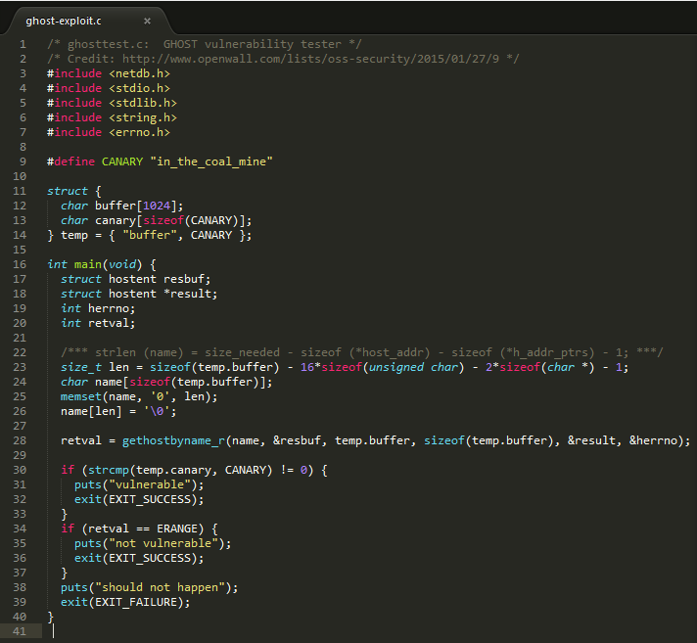
Test glibc exploit code

Slide 8
Patching
Update glibc/libc version using package manager
Guide for specific OS's
  http://www.cyberciti.biz/faq/cve-2015-0235-patch-ghost-on-debian-ubuntu-fedora-centos-rhel-linux/

Slide 9
Is LUG Patched?
Yes, but reboots are needed
Updates and reboots will happen this Sunday @ 8:00pm-9:00pm EST

Slide 10

MTU LUG Advertising!

Slide 11
What we hope to do
Table Tents (Wads, McNair, DHH, and MUB)
Whiteboard 'Ads'
Posters
Class Visits

Slide 12
Why should you join LUG?
Exclusive Shell Server Access
  Includes website hosting ability
Personal Virtual Machine usage
Access to a large community
Quick assistance with Linux issues

Slide 13
In-Class Presentations
CNSA
  Wireless Administration
  MS Administration
  Linux Administration
  Cyber Ethics
  Network Security
  Infastructure Services
CS
  CS1121
  CS1122
  CS1131
  CS1141
  Computer Networks
  Systems Programming
  Concurrent Programming

Slide 14
Community Questions?
Break something?
Fix something?
Want a presentation on a topic?
Now is the time to speak up!

Slide 15

CoreOS
Couple of free T-Shirts!
Tons of stickers!

Slide 16
What is CoreOS?
Minimal operating system
Designed for Docker/Linux Containers
Dual partition Scheme
Designed for clustering machines

Slide 17
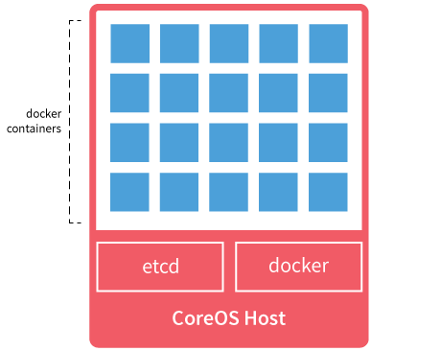
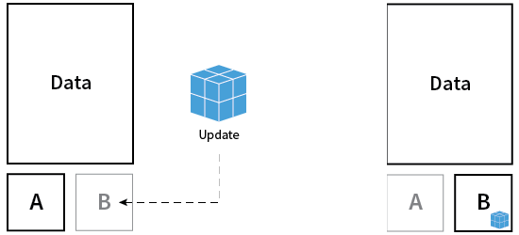

Slide 18
More CoreOS Info?
https://coreos.com
https://coreos.com/docs/quickstart/
https://coreos.com/using-coreos/
#coreos on irc.freenode.net

Slide 19
Winning a T-Shirt & Stickers!
Question will be asked
First person to slap thier hand on the table can answer
Correct Answer = T-Shirt + Sticker!
Tie, those in the tie must state Linux distros back on fourth until one fails.
Incorrect Answer = Sticker Only.

Slide 20
Meeting Adjourned!
Remember to tell your friends to join LUG!
Next meeting will be in two weeks
  Feb. 12th, 2015 @ 5:00 EST

