Slide 1

How to run a Minecraft server
(that doesn’t suck)
Max
Notes:
Gonna be presenting on how to run a Minecraft server
Most importantly, how to run one that doesn’t suck (because most do)

Slide 2
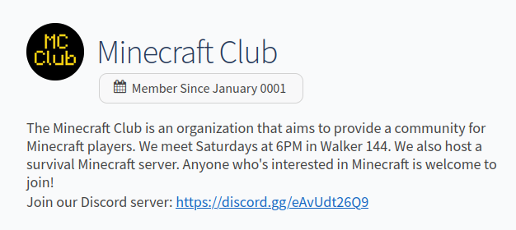
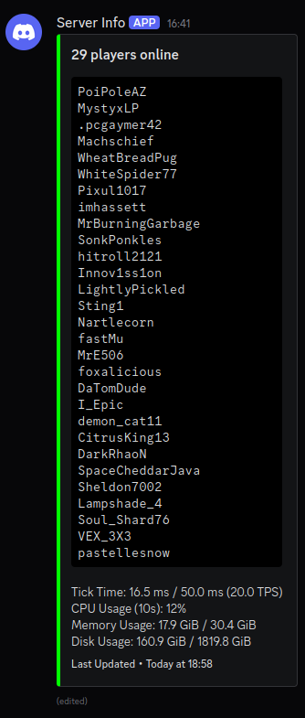

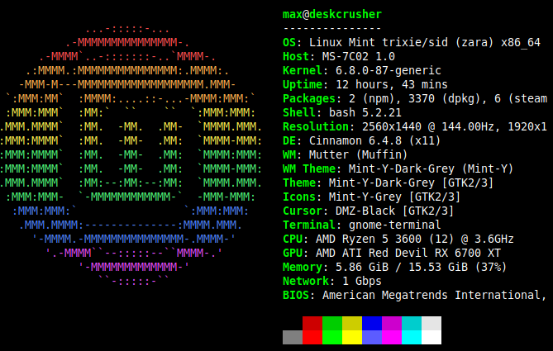
Who are you anyways?
Minecraft Club president
Maintainer for the Minecraft Club and East Hall Minecraft servers
Hosting Minecraft servers for >6 years
Playing Minecraft for almost 10 years
Might know what I’m doing
This is kinda related to Linux right?
Please ask questions if you have them! (I know not everyone here is familiar with Minecraft)
Notes:
Who am I?
President of MC club
I maintain the Minecraft servers for MC club and East Hall
Been hosting servers for over 6 years (since I was like 11)
Playing Minecraft for most of my life
So there’s a small chance I have some idea what I’m talking about
You might be wondering: is this related to Linux? Great question! …
Aware that some people might not know much about MC; I’ll try to explain things somewhat but please feel free to interrupt and ask questions
Also some of this stuff may be kind of opinion based so beware

Slide 3
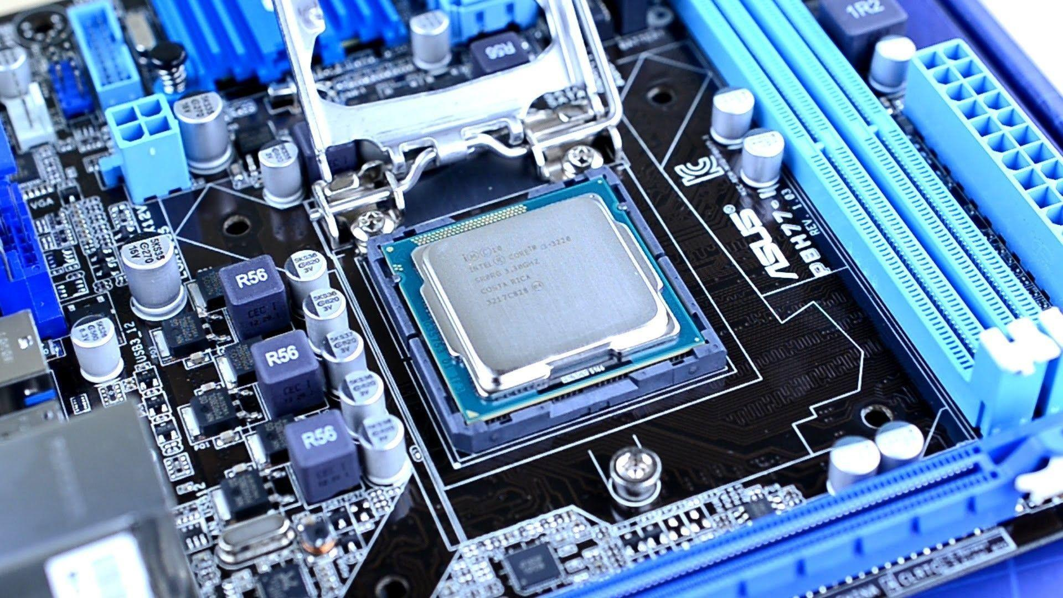

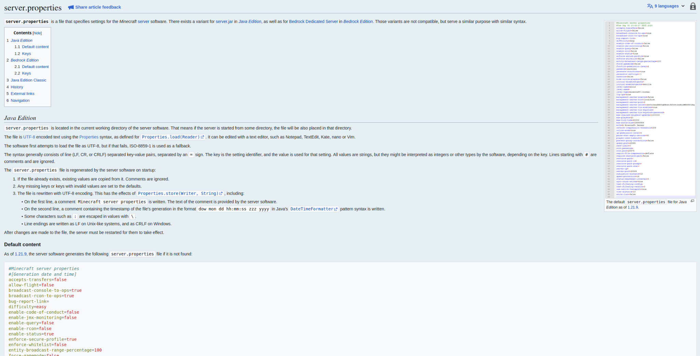
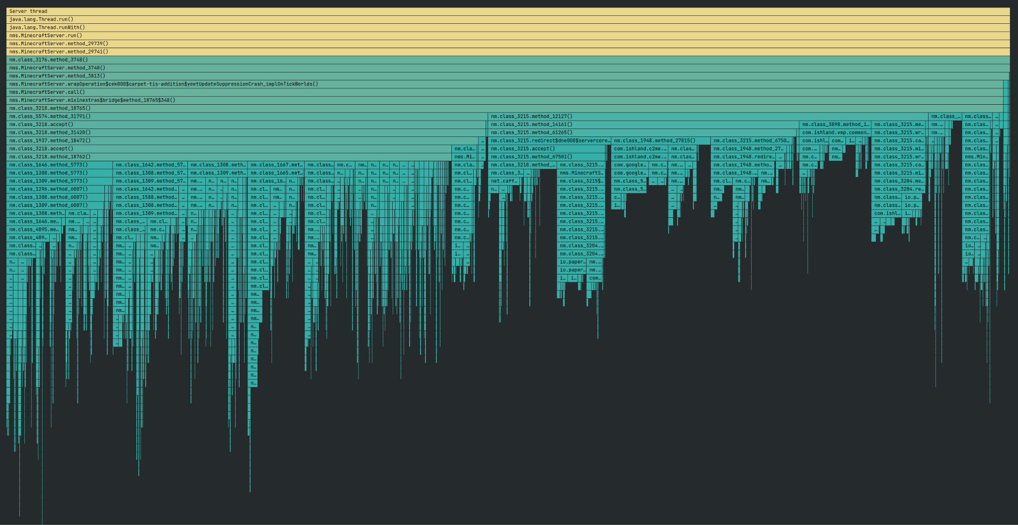

5 main aspects
Hardware
Software
Configuration
Optimization
Management
Notes:
I’ll be going over 5 main aspects of running a Minecraft server: the hardware, the software, configuring it, optimizing it, and managing it

Slide 4
Hardware
Notes:
First and arguably most important thing to consider is hardware

Slide 5

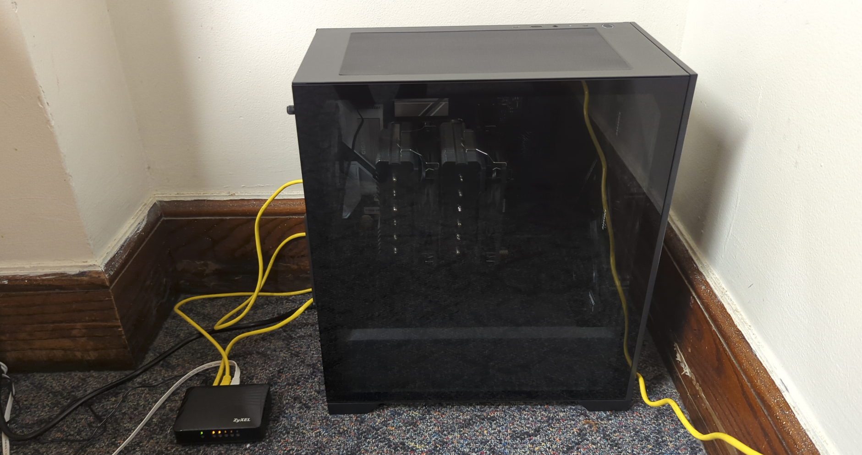
Self-Hosting vs Hosting Services
Hosting services
Easier to set up
Expensive to run ($100-300/mo)
Cheaper servers suck
Self-hosting
More complicated
High initial cost
Low/zero operating cost
Good performance
More customizability
MC Club setup: $830
Hosting: >$150/month
Notes:
Two main directions to go with hardware: self hosting or hosting services
Hosting services are online services that will run your server for you. Generally a lot easier to set up, but quite expensive ($100-300 for a good server). Cheap or even free options: fine if you have like 3 friends you want to play with, terrible for anything bigger
Other option is to self-host. Requires a lot more knowledge and effort, has a higher initial cost. But operating cost is just electricity (free if it’s just in a closet at MTU) and performance can be very good at reasonable budgets. There’s also a lot more customization possible for it.
As a comparison: MC club server was $830. A similar server from a hosting service would be about $150/month. After 6 months you’ve paid more than the cost of the server.
So generally self hosting is going to be your best option if you want your server to both not suck and have it stick around long term (even if you don’t have a constant source of income)

Slide 6



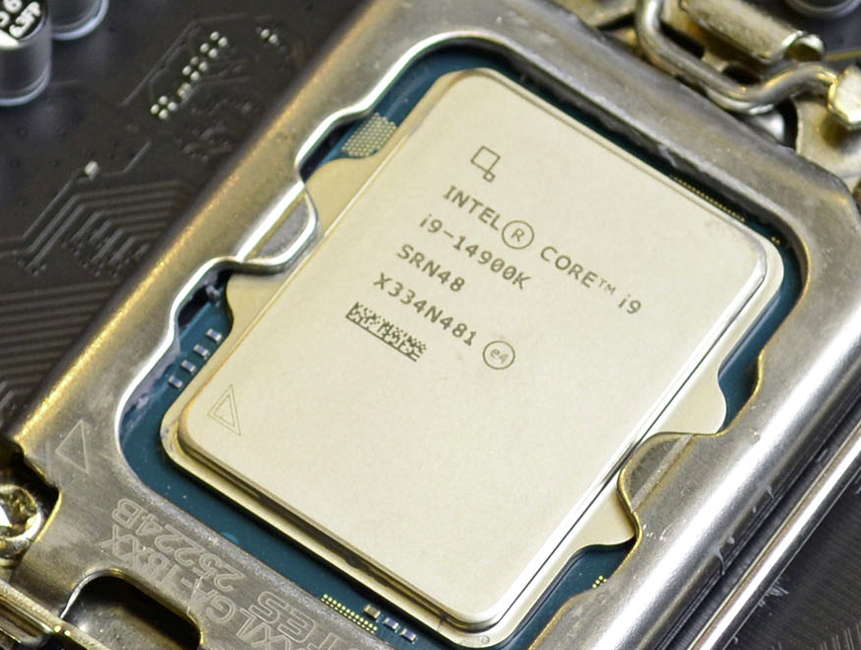

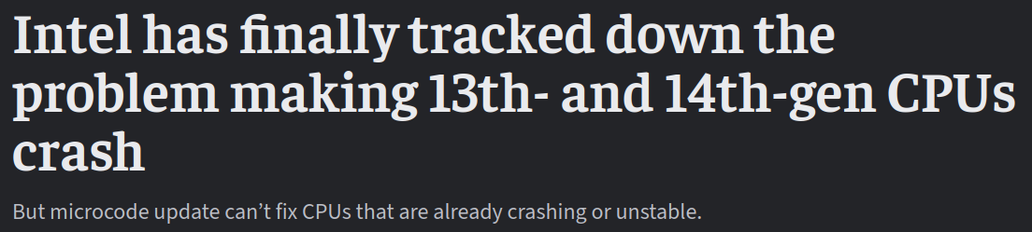
CPU
But why?
Minecraft is overwhelmingly single-threaded
Main game loop happens on one thread
Need good single-threaded performance
Most server CPUs are bad at this, and expensive
Desktop CPUs are much better, and much cheaper
MC Club setup: Intel Core Ultra 7 265K
Cost me $260
#10 on Passmark for single-threaded performance
Generally Intel > AMD for this
(as long as your CPU doesn’t kill itself)
Server CPUs: BAD
Desktop CPUs: GOOD
Notes:
Most important hardware component is CPU
Might be tempted to run it on a server; this is almost always a bad idea. Minecraft servers run much better on desktop CPUs
The reason for this is Minecraft servers are overwhelmingly single threaded. The main game loop that updates (or “ticks”) the world happens on one thread and that’s almost always the server bottleneck. (Which is bad game design but what are you gonna do)
Server CPUs are usually designed to have lots of less powerful cores for multithreaded stuff (more processing power for cheaper) since most server workloads are multithreaded
Desktop CPUs have much better single-threaded performance which makes them good for running a server.
MC Club server uses an Intel Core Ultra 7 265K, which cost only $260 and is 10th place for single-threaded performance on PassMark.
Intel is still mostly the better option for this especially at lower price ranges (as long as your CPU doesn’t blow up, but it seems like they mostly got that figured out)

Slide 7

Memory
How much memory?
Minecraft doesn’t need a lot of memory
16GB enough for most single servers
More likely to hit CPU bottlenecks first
But for multiple servers…
Would be a shame to put all those CPU cores to waste
More RAM => more servers
More servers => more fun?
MC Club setup: 32GB CL32 DDR5-6400 memory
Cost $95 (before RAM crisis)
Room for running a few servers
East Hall asked for one (and paid us!)
Notes:
You also need memory for your server. MC is really not that memory intensive so 16 gigs is more than enough for running a single server, even if you have like 50 people on. You’ll be hitting your CPU bottlenecks before you start running out of memory in almost all cases.
But most CPUs have a lot more than one thread, and since MC only really uses one you can run quite a few servers while maintaining good performance on all of them. But that requires memory for each server, so if you’re doing that you could go for 32 or 64 gigs.
The Minecraft Club server has 32 gigs, which was pretty cheap (as thankfully we got it before the price of RAM went completely insane) and is plenty for running our server, as well as one East Hall paid us to run, and some smaller temporary servers when necessary.

Slide 8

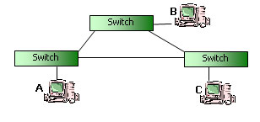


Storage & Networking
Fast low-latency storage
NVME if possible
Please for the love of god no hard drives
Slow storage causes lag spikes on load/save
Worlds aren’t very big (MC Club’s is 50GB)
MC Club setup: 2TB Samsung NVME drive ($120)
Stable low-latency networking
High latency => lag => players hate you
Under 50ms and nobody will really notice
Speed doesn’t matter as much
100/100 is plenty (was our setup for a while)
Asymmetric connections are a bad idea
Notes:
You also obviously need storage and networking.
For storage, it’s important that it’s fast and has low latency. Minecraft needs to load and save world data as players move around in the world and if your storage sucks it’ll cause huge lag spikes.
NVME drives are best for this, SATA SSDs are fine, but whatever you do don’t put the Minecraft world on a hard drive.
We originally had a defective SSD that would randomly take like 300ms for some writes, and it was causing the server to freeze for a solid 10 seconds every 5 minutes when the world saved. With a proper drive it’s a fraction of a second at most.
Minecraft worlds aren’t all that large; the MC club world is only 50GB. But if you want to store backups (which you should) or use mods that use a lot of storage (which I’ll get to) you’ll probably want a few hundred gigs set aside.
The MC Club server has a 2TB NVME drive that cost like $120.
In terms of networking, it’s important that your connection is stable and has low latency. Minecraft isn’t super latency sensitive; as long as people’s ping to the server is under 50ms nobody is going to notice, but it does get annoying when it’s higher. An unstable connection is even worse as that causes unpredictable lag.
Networking speed isn’t super important as MC doesn’t send a ton of data; symmetrical 100 megabit is plenty for reasonable use cases. If you have an asymmetric connection with like 10 megabit upload you’re gonna struggle.

Slide 9
Software
Notes:
That’s pretty much it for hardware, so onto software

Slide 10




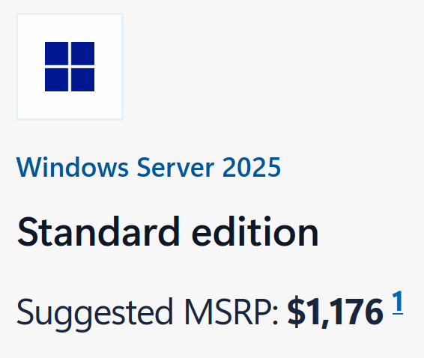



Operating System
Notes:
So first of all you have to choose your operating system. It’s a bit of a tough choice; Windows 11 has amazing feature like Copilot integration and forced automatic updates, while also being cheaper. Windows Server is more built for servers but is a bit expensive. I spent a long time weighing the pros and cons but eventually decided

Slide 11
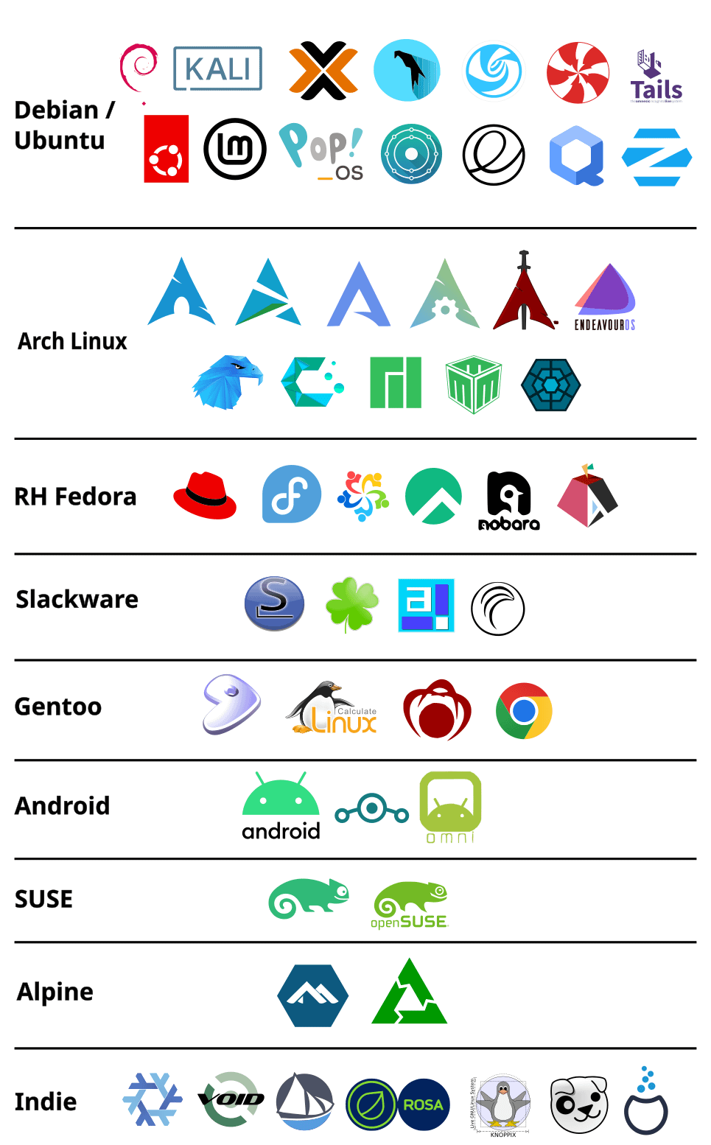
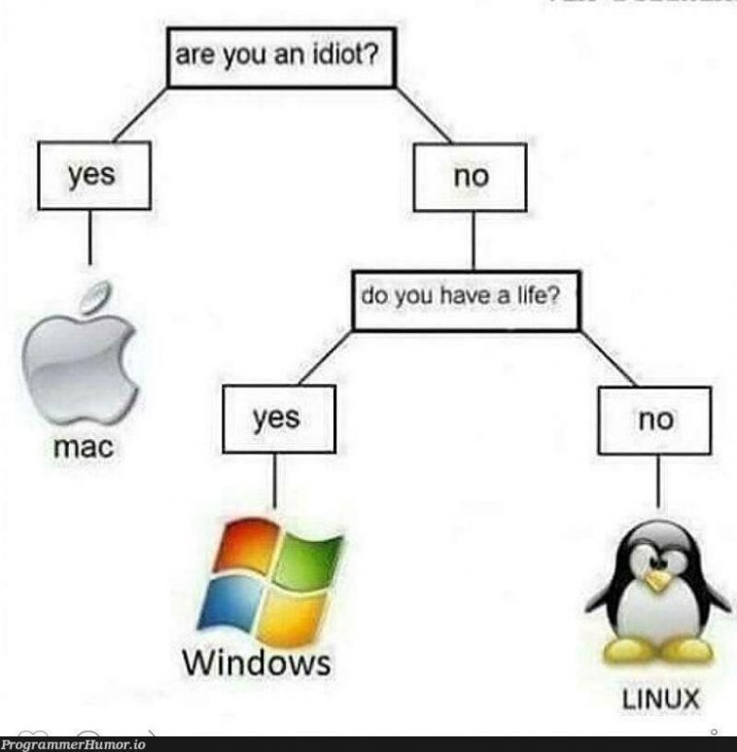


Linux (duh)
What distro?
Doesn’t really matter, pick your favorite
Something stable and meant for servers
Don’t like run a desktop environment
I use Debian btw
Notes:
On Linux (obviously, this is the Linux users group)
The distro you pick isn’t really important, just choose whatever your favorite one for servers is.
Don’t run like stock desktop Ubuntu or something
I ended up going with Debian; I hadn’t used it before but I’d heard good things, and it’s easy to use and quite low maintenance which is nice.

Slide 12
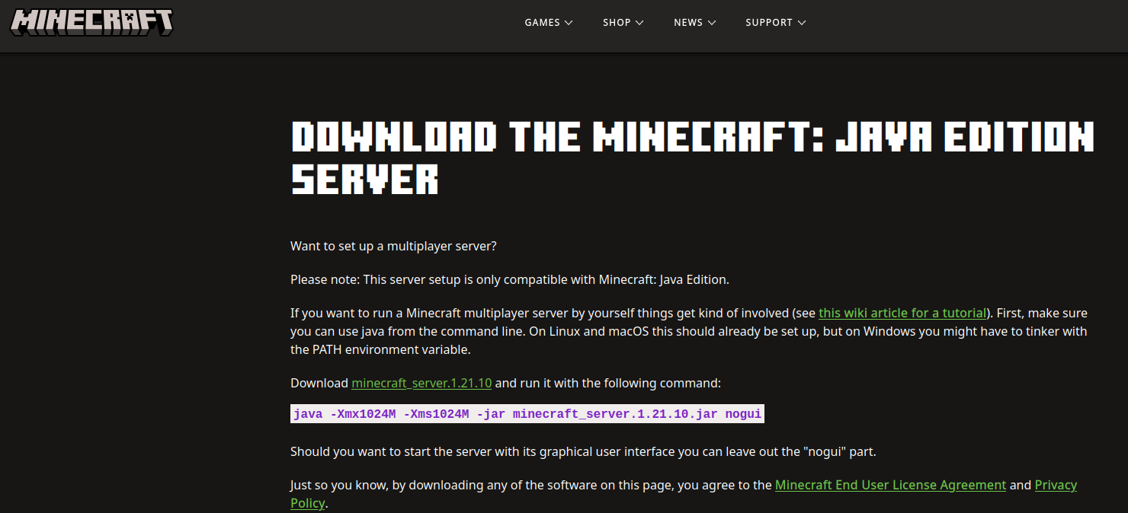

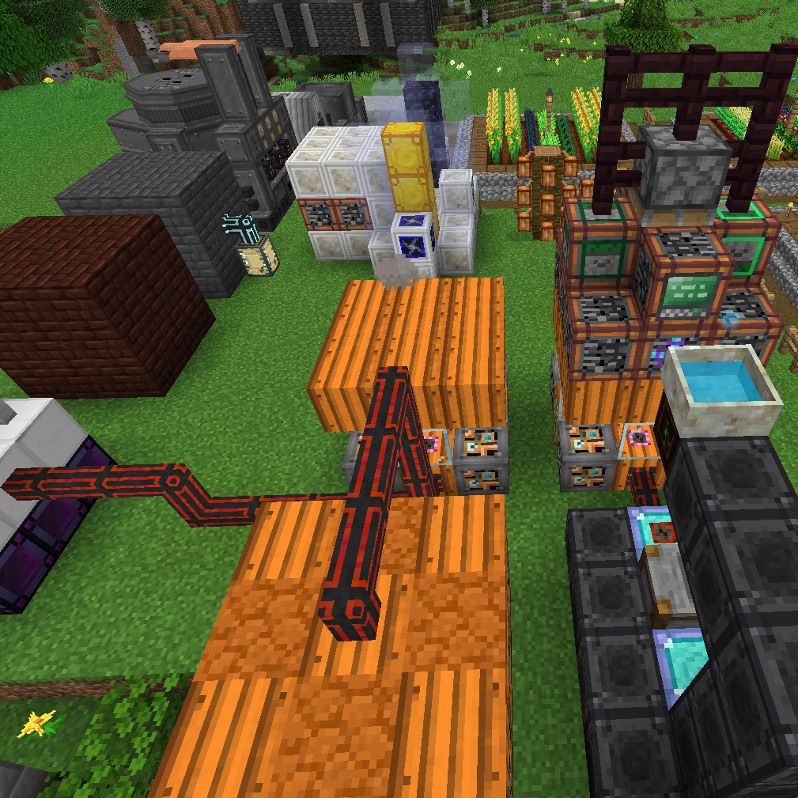


Server Software
Vanilla
Straight from Mojang, not very customizable, usually a bad idea
Fabric (what we use)
Good for vanilla-like servers, can maintain vanilla parity
Allows mods for performance and gameplay improvements
NeoForge
Good for heavily modded servers
Paper
Heavily “optimized” server
Unavoidably breaks vanilla mechanics
Good for stuff like minigame servers
BAD for survival DO NOT USE NO
Notes:
Next up you need to pick your Minecraft server software. There are a few main options:
Vanilla is the stock software straight from Mojang. It’s easy to set up but lacks a lot of customizability and there’s no mod support. There’s not really a reason to use it over the next option which is Fabric.
Fabric is a mod loader; it’s essentially just the vanilla software but with some changes to allow installing mods to alter the game. By default it has full feature parity with vanilla, so everything will work exactly the same on a Fabric server as on a vanilla one. You can change this with mods obviously but many Fabric mods aim to maintain parity themselves.
NeoForge which is basically the successor to Forge is another mod loader. It’s good if you want to play traditional modded Minecraft, with a bunch of mods that change the game a lot. There are lots of big modpacks available for it and it seems like most major mods are made for it. I don’t really do modded MC so I’m not super familiar with it.
Paper is a server software designed to be more “optimized” for servers. It has support for a bunch of different plugins you can install to alter the game. But it has the downside of unavoidably breaking vanilla game mechanics through its optimizations, which is really annoying to players who want to do stuff like build mob farms, or do redstone. It’s good for something like a minigame server where that stuff doesn’t matter, but using it for a survival server is a terrible idea. (Doesn’t stop people from using it anyways).

Slide 13

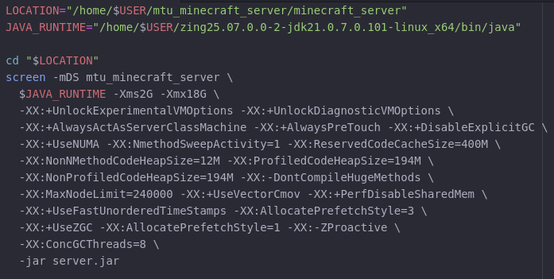
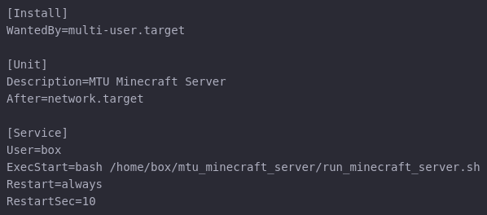

Other Stuff
Java
Use fast JVM for free performance (we use Azul Zing)
Launch script
Use a tmux/screen session to access console
Set good JVM args
Automation
We use systemd services
Other options exist
Networking
Open ports (25565, maybe more)
Configure a domain (IPs look ugly)
SRV records for multiple servers
Or skip all this and use a Docker container someone already made (probably easier but less customizable)
Notes:
There’s a bunch of other stuff you have to do to actually set up the server. The only software requirement Minecraft really has is Java, so you need that. A lot of people don’t know this but there are faster JVMs like Azul Zing that literally just improve performance for free, so you might as well use it.
You should also set up a launch script to actually run the server. It’s good to launch it in a tmux or screen session rather than running it headless so you can access the server console to run commands and stuff. I use screen but I’ve heard tmux is better; I’ll take their word for it.
In the script you need to set proper JVM args; the most important is setting the minimum and maximum memory allocation. I’ve got it set to 2GB minimum, but up to 18GB. Give it as much RAM as it’ll need; as I said before 16 gigs is plenty.
There’s also all these arguments which I mostly just stole from other sources, but they’re supposed to slightly improve performance and avoid lag spikes from garbage collection.
You should also set up some sort of automation for the server. I set up a systemd service that runs the launch script on boot and restarts it automatically if it crashes (which can happen if people do something dumb like creating 30,000 TNT). Makes it nice and easy to stop/start/restart with systemd commands.
And then for networking you should open port 25565 so clients can connect to the server and set up a domain if you don’t want people to have to put in an IP. You can also set up SRV records so if you run multiple servers on different ports people can use a subdomain to connect to a specific one.
There are things that handle all this config for you, like this Docker container, but I prefer setting it up manually as it gives me more control and I know exactly what’s going on

Slide 14
Configuration
Notes:
You also have to configure the server itself.

Slide 15
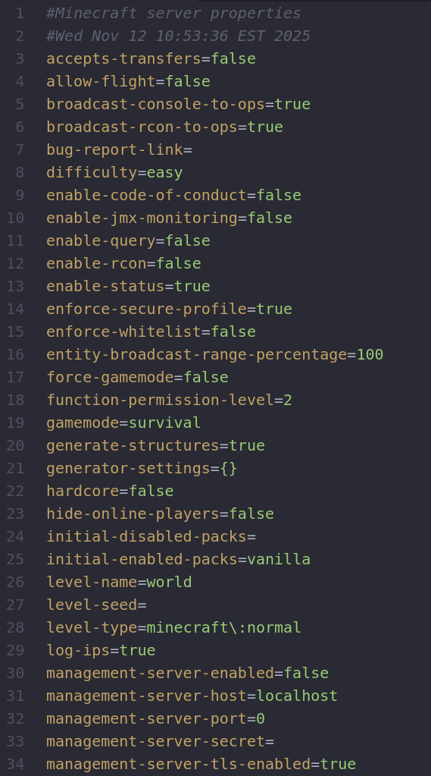
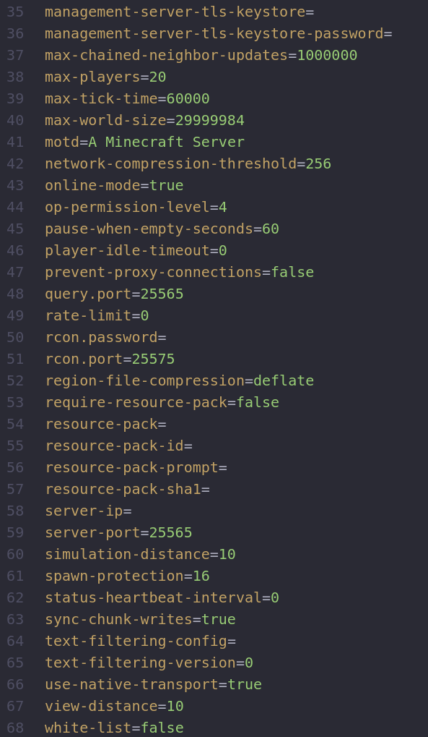
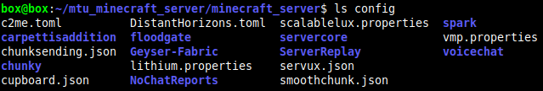
Server Configuration
server.properties (main config file)
Server difficulty
View & simulation distance
World seed
World type (normal, superflat, etc)
Max player count
Whitelist state
Spawn protection (disable this)
Server port (useful for running multiple servers)
Whether to freeze when empty
Region file compression algorithm
And so much more!
config/ directory (mod config files)
Notes:
So the main server config file is server.properties. It has a ton of options [talk about options]
If you install mods, they’ll generally put their configs in the config/ directory in some format or another. The options depend a lot on the mod.

Slide 16



Mods
NoChatReports
Disables chat reporting (literally 1984)
Now Microsoft can’t ban you for what you say
GeyserMC + Floodgate
Allows Bedrock players to join a Java server
Simple Voice Chat
Integrated in-game voice chat
Improves the social experience
Distant Horizons
LoD mod that lets people see super far
Takes up a lot of storage space
Notes:
I’ll briefly cover a few helpful mods; there are thousands but these are all ones I use on the server.
NoChatReports disables Minecraft’s chat reporting feature, which lets people report your messages to Big Brother (AKA Microsoft) and potentially get you permanently banned from joining any server. Always a good mod to have installed.
GeyserMC is a compatibility layer between Java and Bedrock Edition that lets Bedrock clients join a Java server. It’s nice as a way to make the server more accessible, since some people don’t have Java Edition (though the vast majority of players on the MC Club server have Java). Floodgate is an authentication mod that handles Bedrock authentication so people don’t have to do anything weird like linking their Java and Bedrock accounts.
Simple Voice Chat is a proximity voice chat mod that lets people talk to each other in-game. It makes the game more immersive and social and is generally just pretty fun.
Distant Horizons is a level of detail mod that allows the server to send lower resolution world data to the client for distant chunks, so the client (with the same mod installed) can see farther in the world. It’s cool, but it does generate these massive level of detail files that take up a lot of space. Our server has over 70 gigs of Distant Horizons files while the entire world file is only 50 gigs.

Slide 17

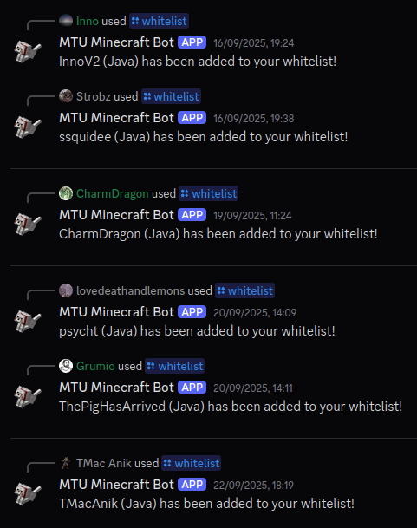
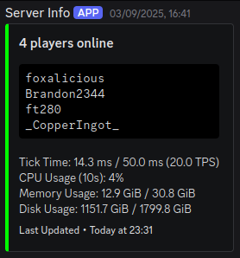
Other Stuff
Chat bridge
Copy messages between Minecraft chat and somewhere else (usually Discord)
Integrates the server into the community
Plenty of existing options (or use a sketchy self-made one like we do)
Auto whitelisting
Unwhitelisted servers are a bad idea
Restrict whitelisting to Discord members
Massively reduces abuse (1 incident in 2 months)
DIY it or steal someone else’s (you can guess which one I chose)
Live server status
Notes:
Some other stuff that’s nice to set up is a chat bridge and auto whitelist system.
A chat bridge essentially just mirrors messages between Minecraft’s in-game chat and some external chat, in our case Discord. It’s a nice way to integrate the server more with whatever community you have and let people see what’s happening on the server at a glance and talk to people. There are some existing options which you can probably just search up, but I made my own because like doing stuff myself (you may have noticed a theme here)
Automatic whitelisting lets people whitelist themselves on the server. Running a completely unwhitelisted server lets anyone join and almost always leads to griefing and other problems, since there are people scanning the entire IPv4 range for servers to join and mess with. With my auto whitelist setup, anyone in the MC Club Discord can whitelist up to two accounts on the server. With our system we’ve only had one malicious person in 2.5 months of operation. I made my own system that’s integrated with the chat bridge system, but there are also existing options.
I also made a live server status message that updates in real time to show some statistics about the server and who’s currently on it. It lets people see at a glance who’s online.

Slide 18
Optimization
Notes:
Now, optimization time. This is definitely one of the most important parts to get right with a server, because nobody wants to play on a laggy server.

Slide 19
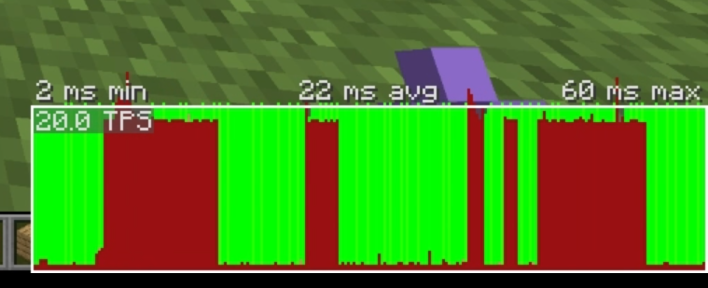
Lag
Spawning (very laggy)
Minecraft tries to spawn mobs every tick
Lots of spawning attempts, all have to check blocks around them for spawnability
Worse with higher simulation distance
Entities (very laggy)
Minecraft ticks entities every tick
Motion, collision, AI updates, etc.
Worse with more entities and more complex ones (villagers are evil)
Block updates (usually not that laggy)
Stuff like redstone, liquid flow, falling blocks
World generation (depends)
Generating new chunks is hard okay
What is lag?
Server ticks the entire world 20 times per second
Ticks must be <50ms or server runs slower than real-time
Very bad gameplay experience
Lag mostly comes from a few main sources
Notes:
So first, what is lag?
The Minecraft server ticks 20 times per second. Each gametick, all the loaded parts of the world are updated. This is the single-threaded process I talked about near the start. Each tick needs to take less than 50 milliseconds on average, or the server won’t be able to finish one tick before it’s supposed to start the other, and the game will run at less than 20 ticks per second. This causes a lot of really annoying effects (like blocks taking longer to break, getting lagged backwards randomly, mobs moving jerkily, interacting with the world taking longer) that everyone hates and you should avoid if at all possible.
The biggest sources of lag, by far, are from mob spawning and entities. Minecraft’s mob spawning algorithm is not the most efficient, and every gametick it makes a spawn attempt for most eligible mobs in every loaded chunk (16x16 area) of the world. This requires checking a lot of blocks and is very laggy when lots of chunks are loaded. It gets worse the higher the server’s simulation distance is, as a higher simulation distance loads more chunks.
Entities can also be very laggy. Every tick, the server has to tick every entity by updating things like its position, velocity, applying collisions, updating its AI, and a bunch of other stuff. It gets worse the more entities you have and the more laggy the entities are. (Villagers have to do a bunch of extra checks for stuff like workstations and so they’re a lot more laggy than, say, an item frame entity).
Block updates are another cause of lag. This is anything changing in the world, like blocks falling, liquid flowing, or redstone updating. Redstone machines are especially laggy because redstone dust uses a very poor algorithm for updating neighboring blocks.
The last cause of lag is world generation. Generating new parts of the world is a pretty complex process (I could do a 2 hour presentation on worldgen alone). If someone’s moving around very quickly it can lag the server. This is less of an issue with more powerful servers as worldgen is one of the few things that is multithreaded and so if you have 20 free CPU cores you can crunch through it extremely quickly. But for lower end servers it can be a really big problem.

Slide 20
Preventing Lag
Decrease simulation distance!!!
Spawning attempts scale with its square
Massively decreases lag at a small cost
We use a setting of 5 chunks
World pregeneration
World generation is laggy
Pregenerate a large area of the world
Tradeoff is disk space
Region file compression
Switch from DEFLATE to LZ4 (faster)
Larger worlds but less autosave lag
Optimization mods
Lithium (general optimizations)
ServerCore (more configurable)
Concurrent Chunk Management Engine (massive worldgen speedups)
ScalableLux (lighting engine)
Krypton (networking)
Very Many Players (high player counts)
Carpet & co. (various settings)
  lagFreeSpawning
  optimizedTNT
  optimizedFastEntityMovement
Notes:
Now that you know what lag is, how do we prevent it?
The biggest thing you can do is just turn down the server’s simulation distance. I talked about this with mob spawning, but decreasing it decreases the radius around the player that the world has to be loaded. This area scales with the square of the simulation distance so decreasing it can help massively with spawning lag. It also helps with entity lag since fewer entities will be in simulation range from a given player. It does have some disadvantages, like entities not despawning properly outside of simulation distance, but they’re pretty minor overall compared to the lag reduction.
Another thing is world pregeneration. You can generate a large part of the world around spawn so that players aren’t loading new chunks most of the time. This significantly reduces world generation lag, since most people won’t be going super far from spawn all the time. It does have the cost of larger world files, but it’s still not too bad; MC Club’s world was pregenerated out to 8000 blocks and is still only 50GB. It can also take several hours for large worlds but you can do it ahead of time so that’s usually not a big issue.
A small thing to reduce lag spikes during the world autosave is something I mentioned in server.properties: switching the server’s region file compression algorithm from DEFLATE to LZ4. LZ4 is much faster and reduces the time it takes to save the world. It does make the worlds a bit larger but the difference is pretty minor.
Finally, there are tons of mods that optimize various aspects of the game. These are the ones I use. They all preserve vanilla parity by default which as I said is important.
Lithium and ServerCore do a bunch of general optimizations to various parts of the game to make it run more quickly.
Concurrent Chunk Management Engine revamps the world generation engine and speeds up worldgen by an insane amount. It also makes it effectively utilize all the CPU’s cores. It basically completely eliminates worldgen lag as long as you have a pretty good CPU.
ScalableLux optimizes the lighting engine, which is responsible for updating light levels in the world. It’s not a huge source of lag most of the time as it actually runs on its own thread but it’s nice to have.
Krypton optimizes some things about the network stack; I’m not entirely sure what it does but we use it so yay.
VMP has various optimizations that help the server run better at high player counts.
Carpet and its extensions has a lot more features than optimization that are really useful, but in terms of optimization it has some spawning optimizations and optimizations for TNT explosions and extremely fast moving entities. The spawning optimizations are quite good, but the other ones aren’t really useful in most cases unless you’re building some very technical TNT cannons which are a bit out of scope for this presentation.

Slide 21
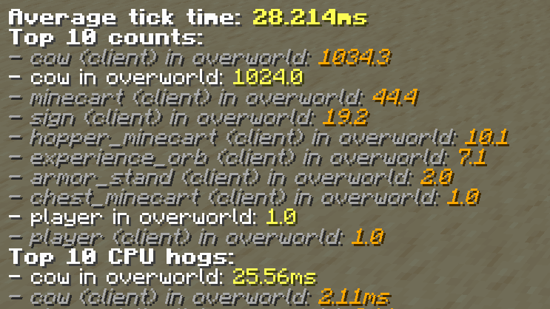
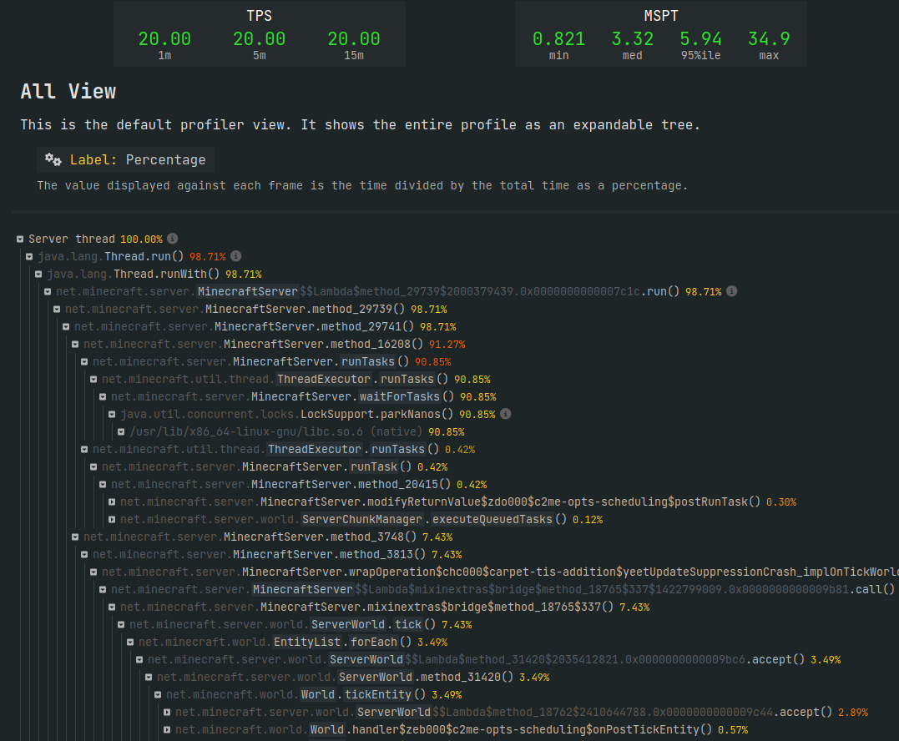
In-game Lag Reduction
Minimize laggy entities or move them to infrequently loaded areas
Avoid high entity counts like mob pens
Prevent colliding entities (overcrowded mob pens are extremely laggy)
Spawnproof spawnable areas
Disable laggy redstone machines
Profiling
See what’s lagging the server
/profile health, /profile entities
Profiling mod Spark for granular profiling
Notes:
You can also take steps in-game to reduce lag.
The main thing is just to minimize how many entities you have loaded. You can move laggy entities you need to areas that aren’t loaded frequently by players, or just kill them. Preventing entity collisions is also super important; when a bunch of entities are packed together tightly they all have to process collisions with each other every single tick and it’s extremely laggy. People like to make overcrowded mob pens that basically just turn into lag machines.
Other lag reduction methods include spawnproofing spawnable areas to avoid the spawning of mobs that then need to be ticked themselves. If you have laggy redstone machines disabling them can also help with lag, though this isn’t too common.
You can also profile the game to see what exactly is causing lag. The /profile command lets you see what’s responsible for the tick, and /profile entities shows you how laggy different types of entities are. For example, in this screenshot you can see that there are over 1,000 cows in the world responsible for 90% of the time the server takes to tick. There’s also a mod called Spark that provides very granular profiling, showing you exactly what Java methods are responsible for the most lag. It gives you a breakdown of stack traces just like any debug profiler would. This is how I figured out my SSD was defective and causing 10 second lag spikes; the server was waiting for insane amounts of time on I/O operations.

Slide 22
Management
Notes:
A very important aspect is actually managing the server once it’s up and running. Running a server is a fair bit of work and it’s good to keep some stuff in mind.

Slide 23
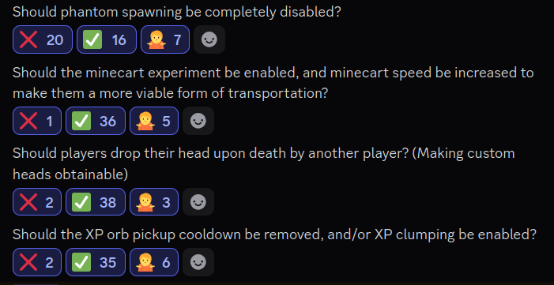
Administration
Don’t cheat (generally)
Nobody likes an admin who cheats
Use admin privileges for admin purposes only (monitoring players, lag testing, etc.)
Okay in some circumstances (like a player losing items due to lag)
Be transparent and predictable
Clearly communicate server info (mods, gamerules, other settings)
Let people know about changes and downtime ahead of time
Don’t make changes without serious thought (especially ones that affect vanilla mechanics)
Listen to your community
If everyone wants something, strongly consider it
Polls are a great tool for this (but don’t blindly follow their results)
Notes:
First of all, server administration. A big thing is to be transparent and predictable. You should communicate info about the server clearly like the mods it has and various settings you have configured. This lets people know what to expect from it. It’s also important to communicate server changes and any downtime ahead of time so people have time to prepare or talk about it. Also, it’s usually a bad idea to change core vanilla game mechanics, as it can break a lot of things like farms that people rely on. I did this by accident when I changed minecart behavior to make them a more viable form of transportation; I ended up breaking a complicated minecart-based farm and had to revert the changes.
Also, listen to people! If everyone agrees that they want something changed on the server, you should consider it. You can run polls to assess the consensus on such things; I ran several around the start of the server. However, don’t follow their results blindly; you still need to be careful when making any changes (the minecart poll was voted against by nobody but still caused problems).
Also this might be obvious, but don’t cheat as an admin. I’ve seen plenty of server admins who will just spawn items or builds in and it’s not very fun for the players. If you’re going to be an active participant in the server it’s good to stick to playing legit. This doesn’t apply to using commands for admin purposes like looking at suspicious players or testing lag obviously. And there are some circumstances where cheating is the best choice, like when players lose items due to things like lag (which are kinda your fault as an admin). But this should be a very rare occurrence and only happen with good reason; not just because someone fell in lava and lost their stuff.

Slide 24
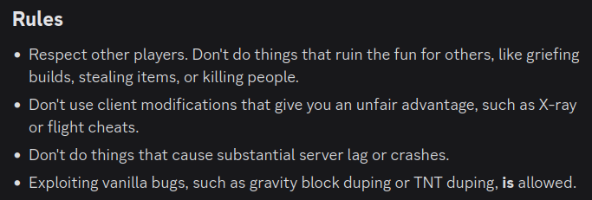
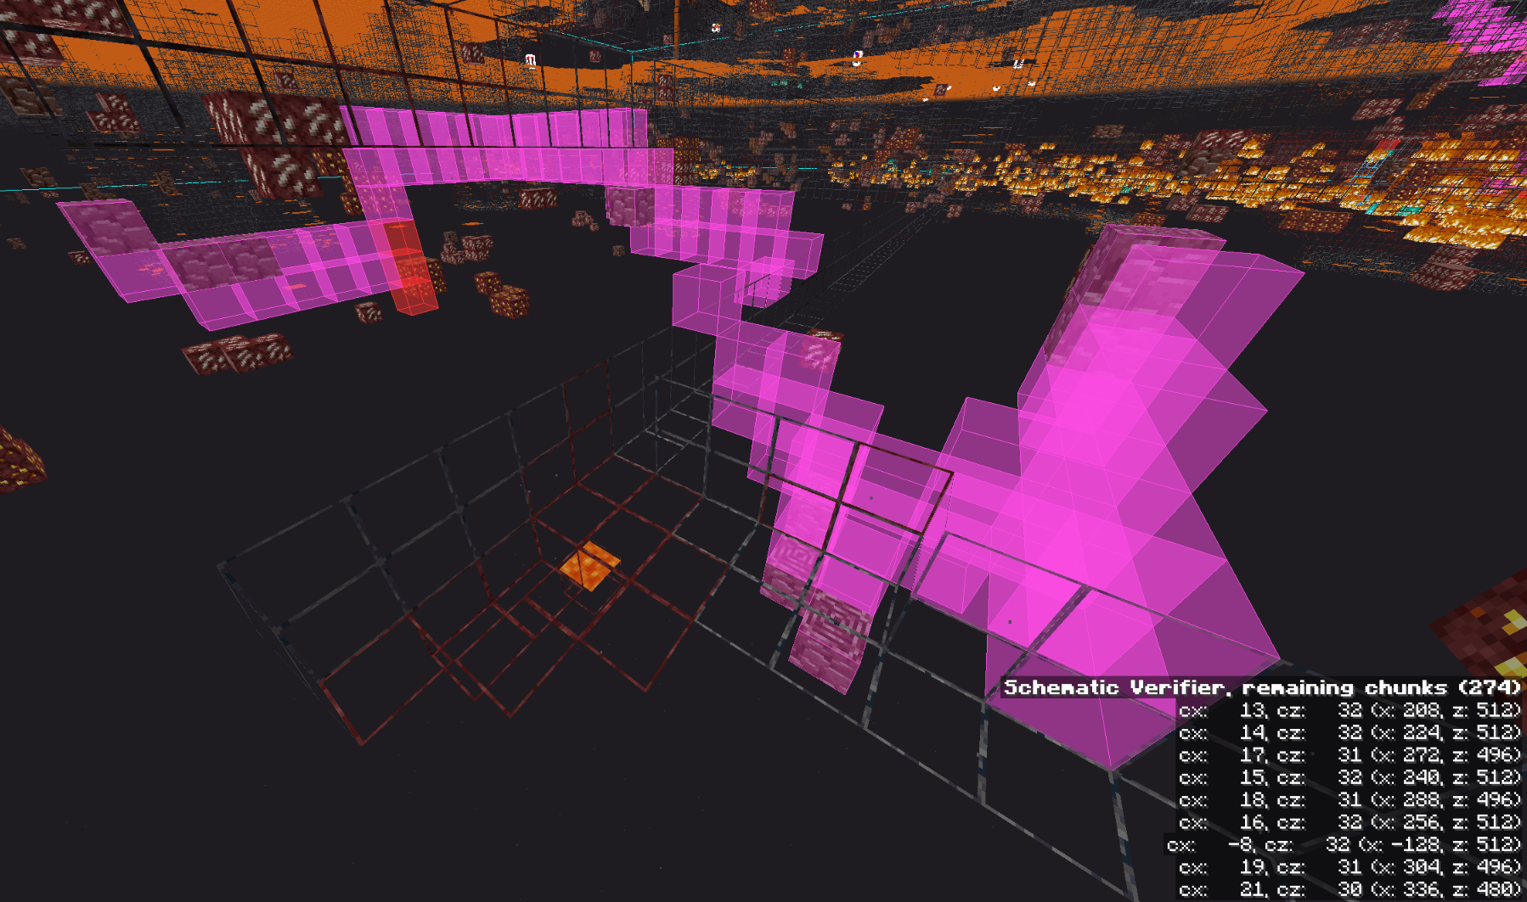
Moderation
Set clear expectations for players
What to do, what to not do
Simple is fine; you don’t need a huge list of rules
Moderate effectively
Warn players acting in good faith (people make mistakes)
Ban players for repeated offenses or blatant rule-breaking
Once again, whitelisting is a very good thing
Notes:
And speaking of payers, moderation is also super important. Having clear rules and expectations for people lets them know what kind of server they’re playing on and stops most bad behavior. They don’t have to be complicated either; my rules basically just boil down to be nice, don’t cheat, and don’t lag the server.
You should also effectively moderate people. If someone is acting in good faith and just doesn’t know about/understand the rules, give them a warning and move on. But if it turns into a pattern of bad behavior, or someone’s blatantly breaking the rules, you should ban them right away.
This screenshot is from a guy who joined and immediately started X-raying for ancient debris. Very not suspicious tunnel.
And once again whitelisting helps immensely to cut down on bad players as it puts a big restriction on who can actually play on the server (Tech students or their friends).

Slide 25
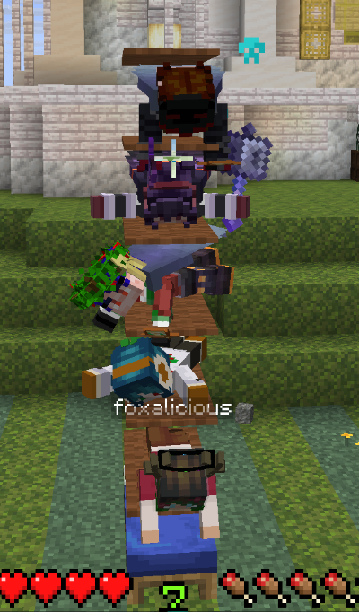
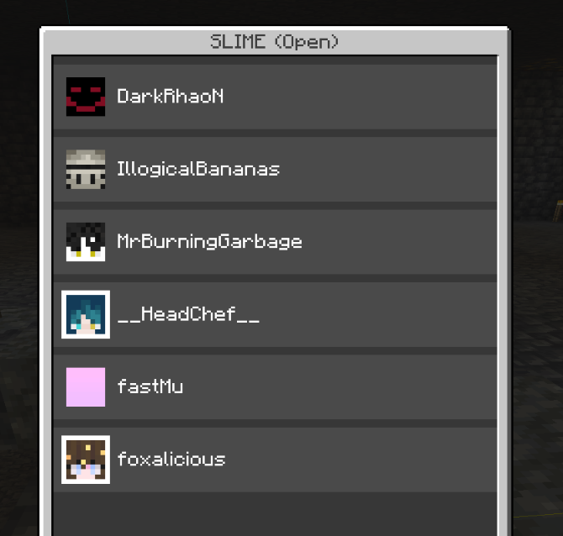
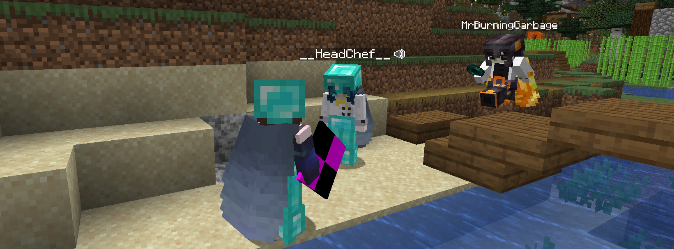
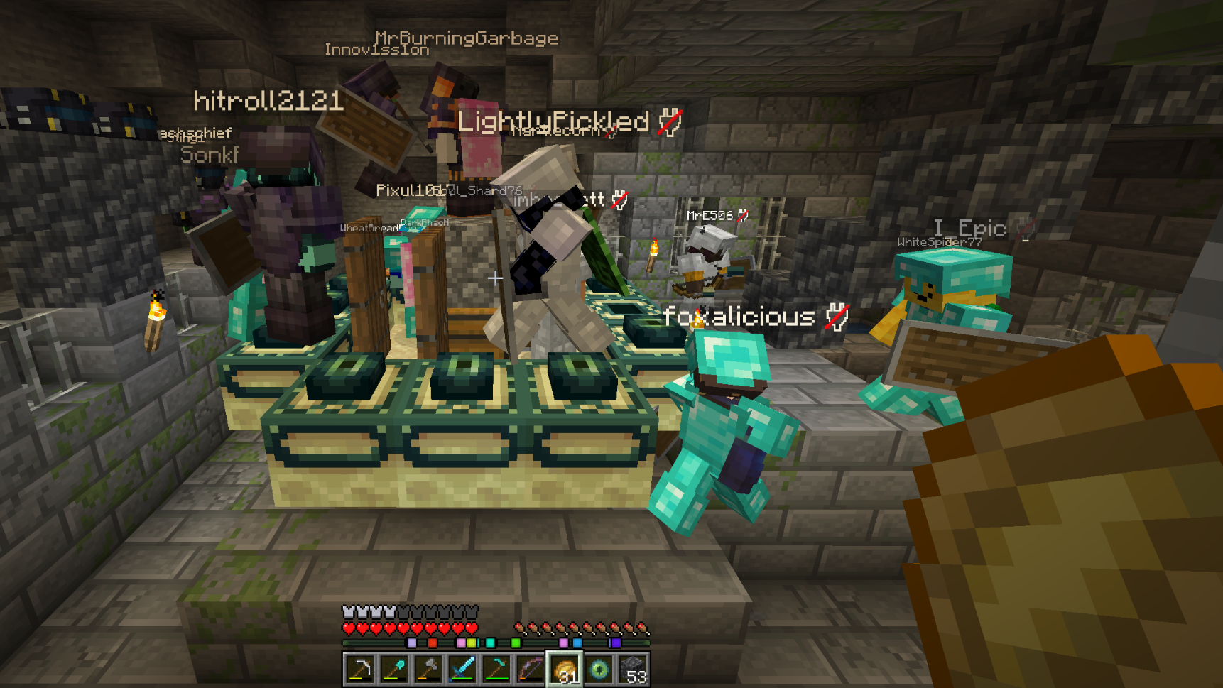
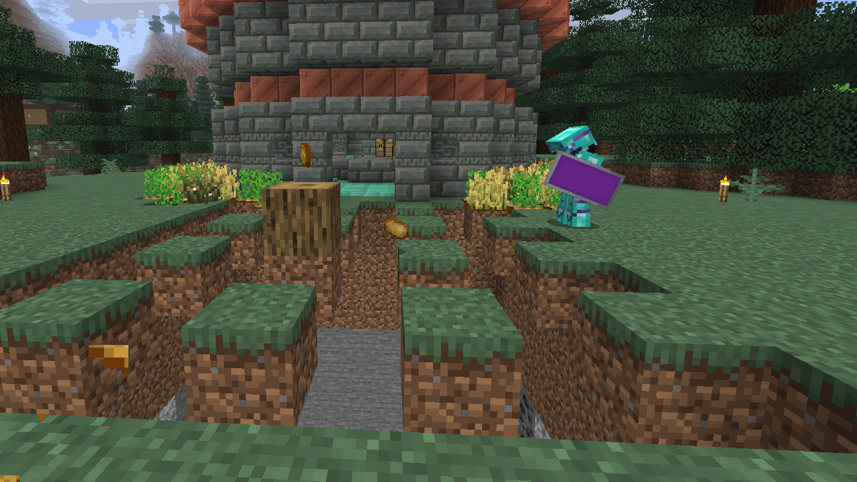
Have fun!
Notes:
And most importantly, have fun! Minecraft! Yay! Just because you’re the admin doesn’t mean you can’t have fun too.

Slide 26
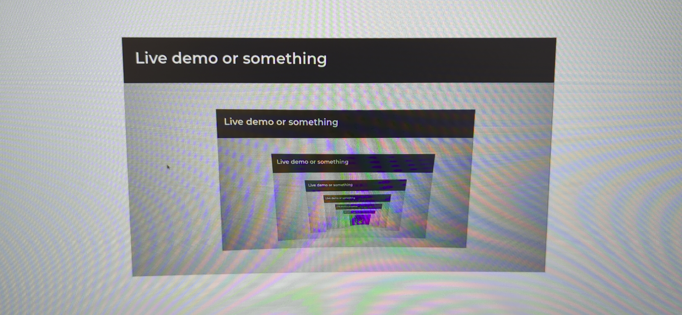
Live demo or something
Notes:
Anyways time for a live demo of sorts where I show off my setup

Slide 27

Notes:
I don’t have the server here, obviously, so here’s a picture of it just before it was moved to Dillman Hall
SSH into server
Show off server directory and scripts and Discord bot and world backups
Show off systemd service
Show off actual server directory and server.properties and mods and stuff
Show off server console
Log into server and look around a bit
Show off profiling

Slide 28


The End
Thanks for listening to me ramble about Minecraft for way too long
I hope you’re better informed now
Join the MC Club Discord: https://discord.gg/eAvUdt26Q9
Notes:
Anyways that’s the end

