Slide 1
Computer Rescue Idea
Presented to MTU’s Linux User Group
Professor Timothy Keirnan
9 OCT 2025

Slide 2
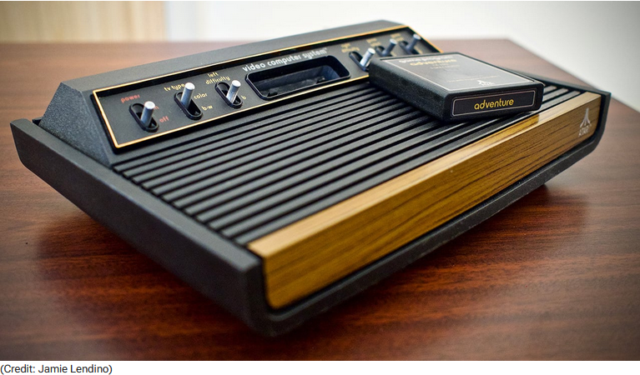
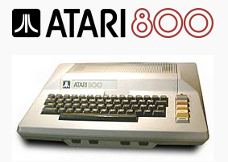
Who is Professor Keirnan?
I am Generation X, blessed with Atari 2600 and Atari 800 computing origins.
PC Magazine The Atari 2600 at 45
RetroTech Collection

Slide 3
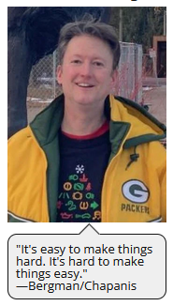
Who is Professor Keirnan?
At Michigan Tech, I teach these courses that I hope you consider taking:
STC 3628 User Research
HU 4635 Principles of User Experience Design
HU 4628 Usability Evaluation
HU 4632 Special Topics in User Experience
HU 3120 Technical and Professional Communication
Part of my attending LUG is to learn to use Linux better in my home life. I need your help on a couple things.
BUT something else is on my mind this year...

Slide 4
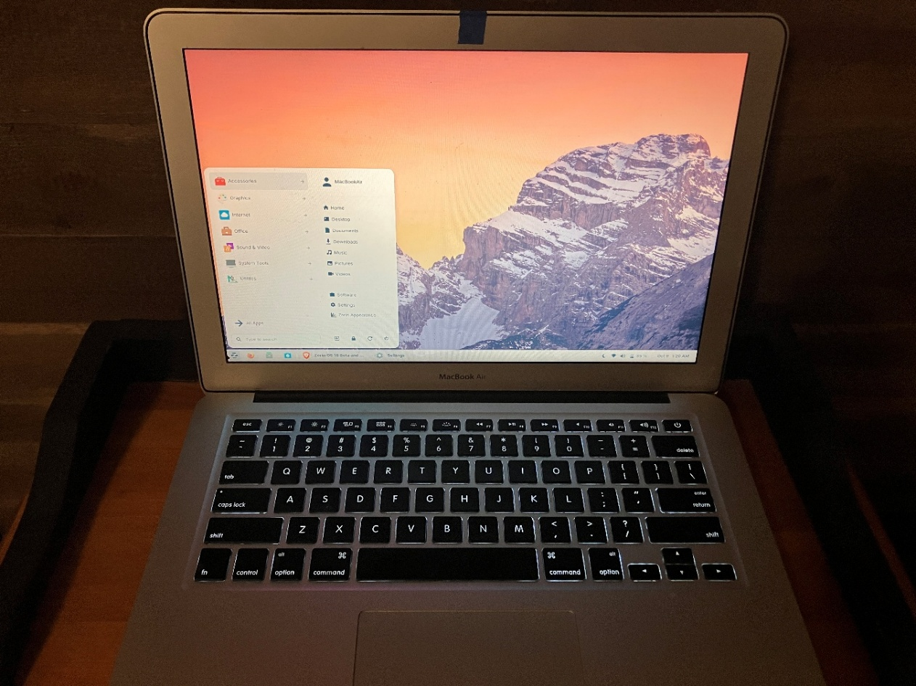
My hobby is giving older, no-longer-supported computers a second life with Linux as their operating system.
2017 MacBook Air with ZorinOS and a new battery. Good as new!

Slide 5
FACT:
E-waste sucks and it’s getting worse. What is going on?

Slide 6
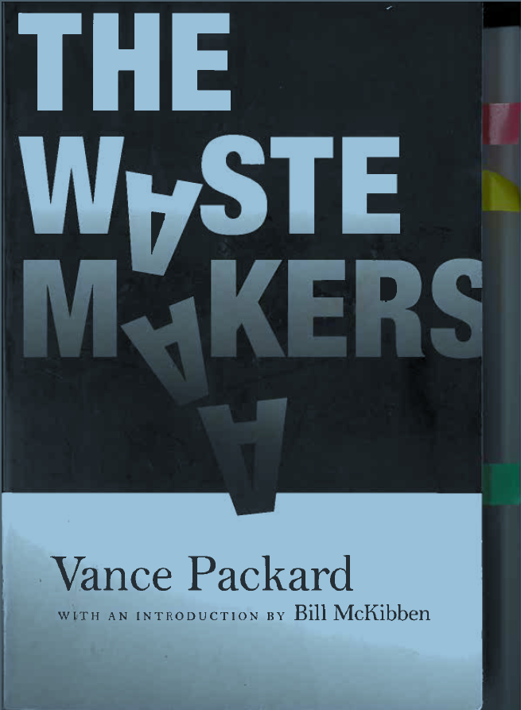
Prescient book from 1960
This book brought attention to the concept of planned obsolescence, in which a “death date” is built into products so that they wear out quickly and need to be replaced.
Does this sound familiar to October 2025 right now, when Microsoft is refusing to allow perfectly good hardware to run Windows 11 so people have to buy new machines?

Slide 7
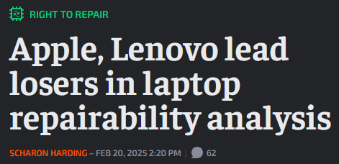
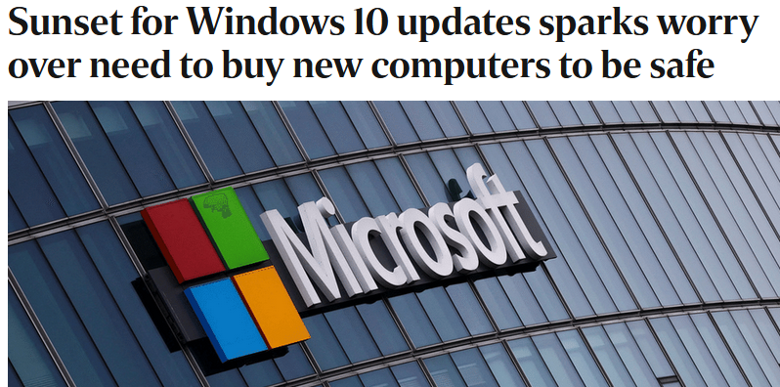
Computing in 2025 ☹
As if Apple’s descent into absurdly thin, non-repairable devices isn’t bad enough. . .
. . . we get this crap from Microsoft to scare Windows 10 users in the USA into buying new computers so they can move to Win11.

Slide 8

Let’s stop this e-waste!
What if, instead of a pet rescue as with animal shelters, there was a computer rescue group in the Copper Country to save old machines from landfills?
MTU students and local households could benefit.

Slide 9
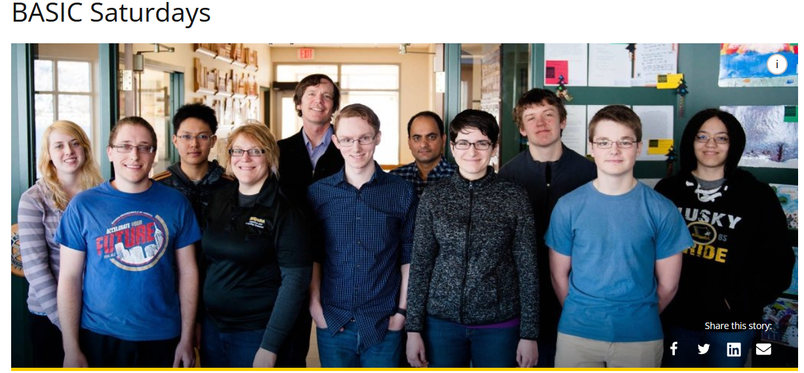
Anyone heard of this B.A.S.I.C. group by Profs Steelman and Wallace? They visit local libraries to help folks around here with their computers. I hear it’s starting up again soon.

Slide 10
Summary
There are many perfectly good Win7 and Win10 machines around that can’t run Win11.
Plenty of Intel-chip old Macs are around, too, unable to run the more current versions of MacOS.
Linux Mint has become really great over the past five years and runs well on older hardware with minimal RAM. It is also not a privacy disaster as Windows, MacOS, and ChromeOS are.
Let’s talk about how we might work with students and campus departments to rescue Copper Country computers in a future LUG meeting (not tonight). I welcome your thoughts. tskeirna@mtu.edu
316 Walker is my office.

Slide 11
Topics for future LUG discussion
I will talk with the Sustainability program in Social Sciences that you told me about tonight. Thanks! But maybe we should talk once more together before I do that.
I will also talk with Computer Science, Humanities, and College of Business.
How would we deal with storage drives on rescued machines? People’s data is personal and tricky and we don’t want to be blamed for erasing someone’s old data they didn’t pull all the needed files off the machine.
Linux’s GRUB bootloader is unreliable for dual booting in my newbie experiences. I strongly feel that a rescued computer should run only Linux. Thoughts?
Is Linux Mint the best distro for us to use in computer rescues? I love it but I don’t want to presume anything.
How could we donate rescued computers without becoming somebody’s IT Help Desk forever when they have questions?
How would this computer rescue idea impact local computer shops? Could they be almost partners in the effort, or are they just Windoze or Mac places?

